Slide 1
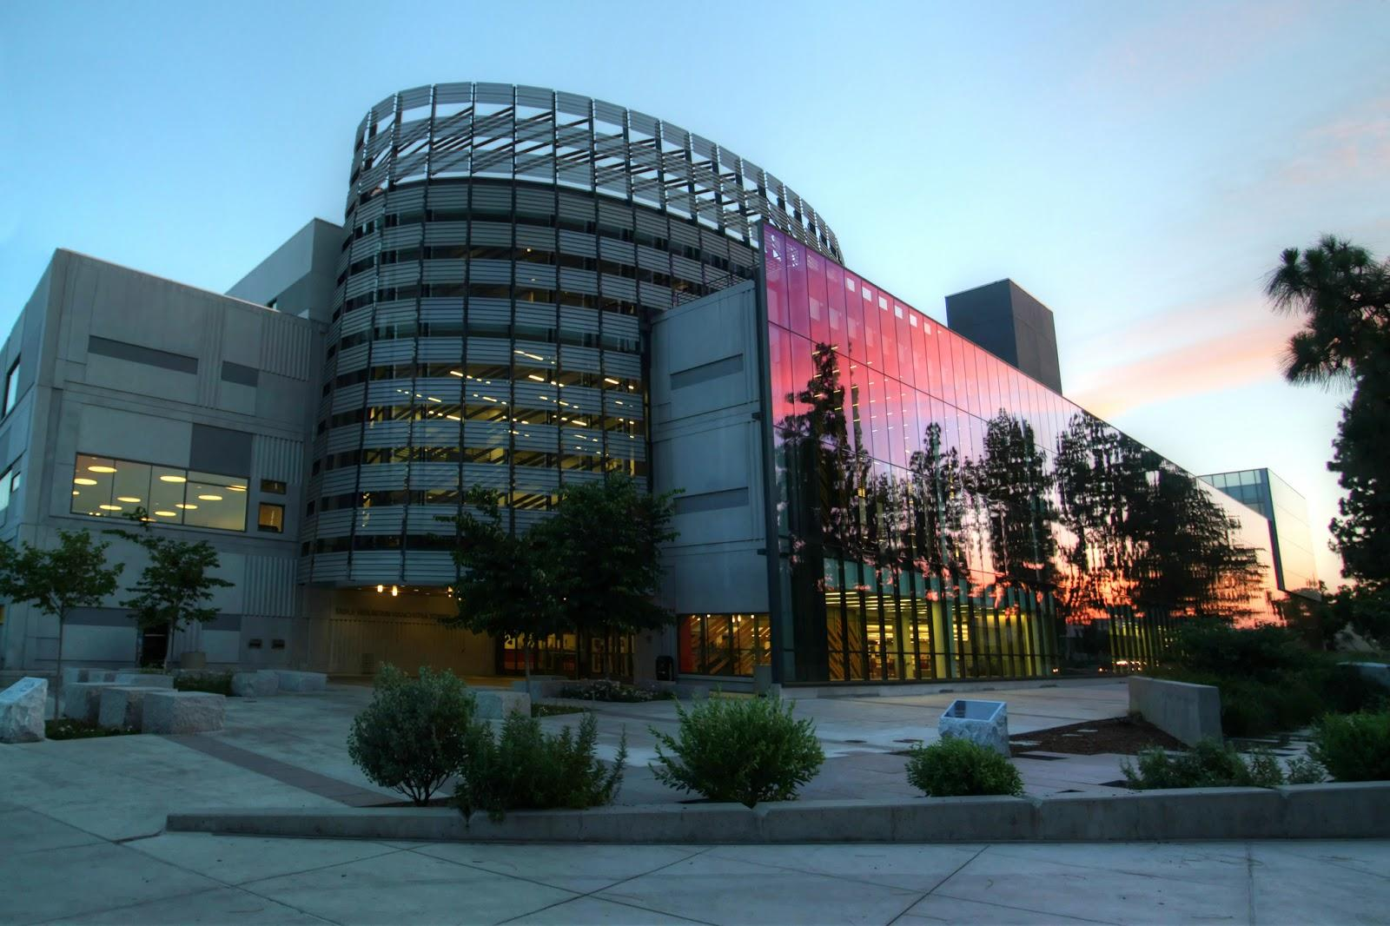
Supporting Diversity Programming, Services and Resources in the Academic Community
Henry Madden Library
California State University, Fresno
Raymond Pun, Hiromi Kubo, Lucy (Tiewei) Liu, Arturo Mendoza

Slide 2

Our Mission, Value and Vision

Slide 3
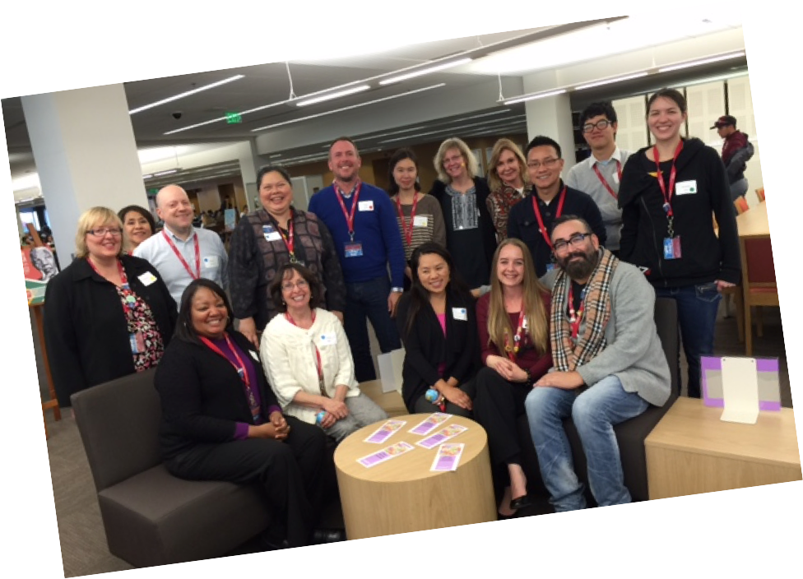
LIBRARY DIVERSITY COMMITTEE

Slide 4
ClimateQUAL Assessment
Diversity Awareness Training
Diversity Involvement Initiative
Diversity Lounge
DIVERSITY AWARENESS
IN THE LIBRARY

Slide 5
DIVERSITY PROGRAMMING
Student Outreach
Displays and Exhibits
Collaboration

Slide 6

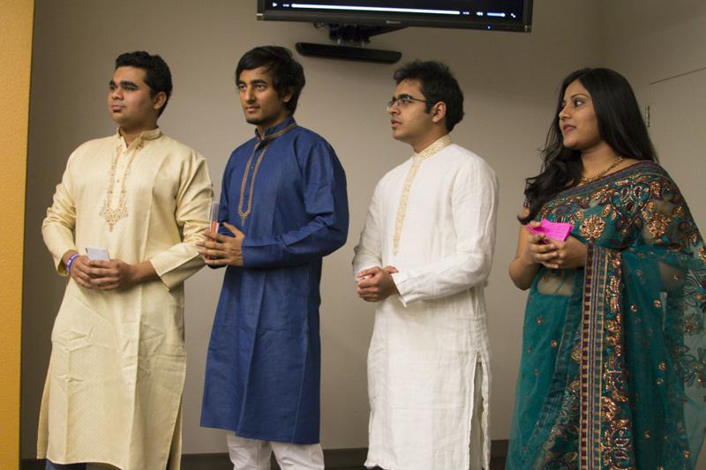
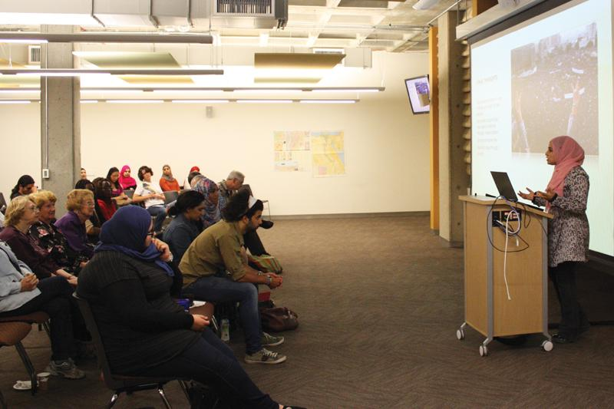
INTERNATIONAL STUDENT OUTREACH

Slide 7
International Coffee Hour (ICH)
Orientations and workshops for international students in the semesters
American English Institute Conversation Partner Program
International Education Week
Study Abroad Fair
INTERNATIONAL STUDENT OUTREACH

Slide 8
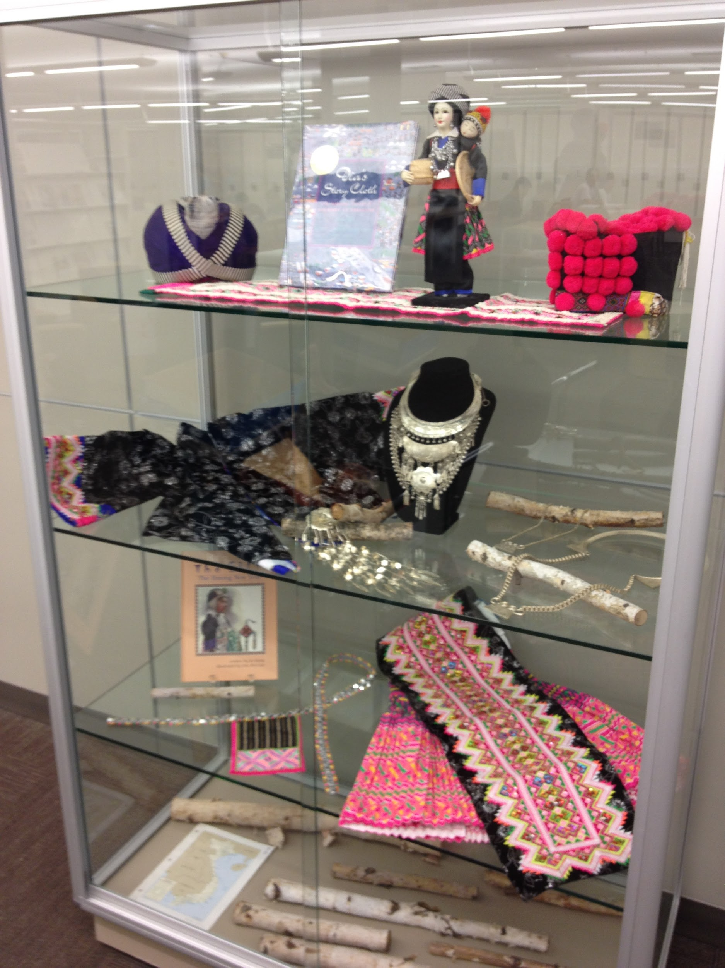
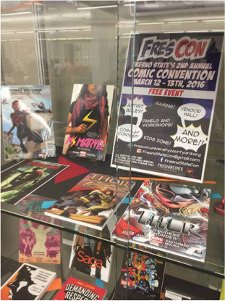
Diversity in Geek Culture
DISPLAYS & EXHIBITS
Celebrating Hmong Culture

Slide 9
Stamp My Passport!
Intersectionality
We Are EQUAL to the Task
Sorting Out Race
Native Voices
DISPLAYS & EXHIBITS

Slide 10
Partner with different departments
Host “Unplugged” open house receptions for various campus diversity groups to exchange information
Delegate Committee members to various diversity groups and initiatives
Off-campus collaboration for service learning and public programming
COLLABORATION

Slide 11
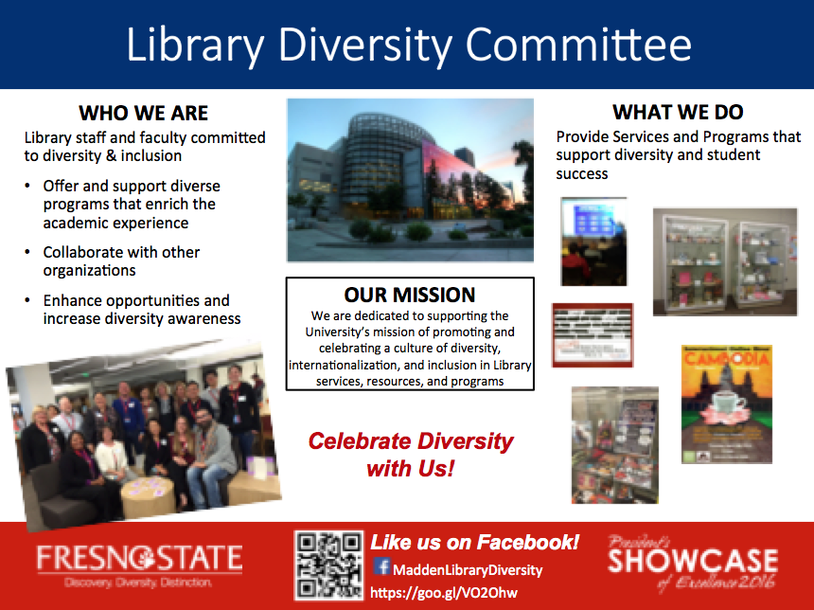

Slide 12
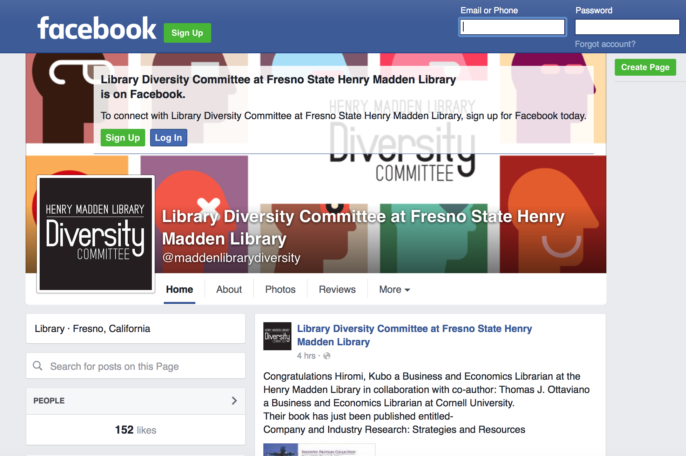

@maddenlibrarydiversty

Slide 13
THANKS!
Questions?

