Slide 1

Proposed Impaction Plan – Fall 2017

Slide 2
Impaction Status
Current
  Nursing
  Athletic Training
Proposed – Fall 2017
  Exercise Science
  Deaf Studies
  Deaf Education
  Interpreting
  Pre-Nursing

Slide 3
Factors Contributing to Proposed Impaction
Enrollment growth
Number of waitlisted students
Advising ratios
Federal grants
Acceptance rate into major

Slide 4
Kinesiology – Exercise Science
Rationale
Increase timely progress to graduation
Competitiveness for professional programs
Proposed after consultation
  First Time Freshman
    Local area: 3500 (from 3100)
    Non-local: 3900
  Transfer
    Local area: 3.0 (from 2.3)
    Non-local: 3.2

Slide 5
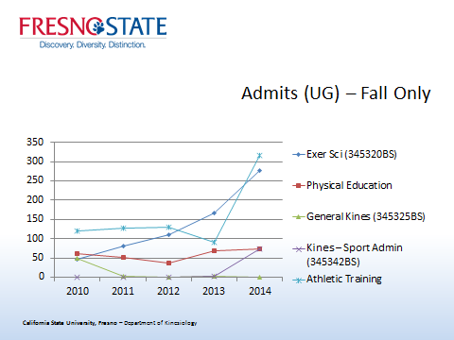
Kinesiology Undergraduate Majors

Slide 6
Communicative Disorders and Deaf Studies – Deaf Studies, Deaf Education, Interpreting
Rationale
- Target ASL Programs at Community Colleges
- Recruit students to meet federal grant requirements
- Scholarships for between $15,000 - $17,000 over two years
Proposed after consultation
  First Time Freshman
    Local area: 3100
    Non-local: 3300 (from 3900)
  Transfer
    Local area: 2.3
    Non-local: 2.7 (from 3.2)

Slide 7
Nursing – Pre-Nursing
Rationale
- Proactively assisting students in identifying a major leading to academic and career success
- More applicants than our capacity – many become ineligible to apply for the nursing program
Proposed after consultation
  First Time Freshman
    Local area: 3500 (from 3100)
    Non-local: 3900
  Transfer
    Local area: 3.0 (from 2.3)
    Non-local: 3.2

Slide 9
Implications
Outreach
Advising
Change of majors

Slide 10
Questions?

