Slide 1
CSU Bakersfield
University Strategic Planning
& Budget Advisory Committee
Monday, December 4, 2017
Mr. Thom Davis, vice president and chief financial officer

Slide 2
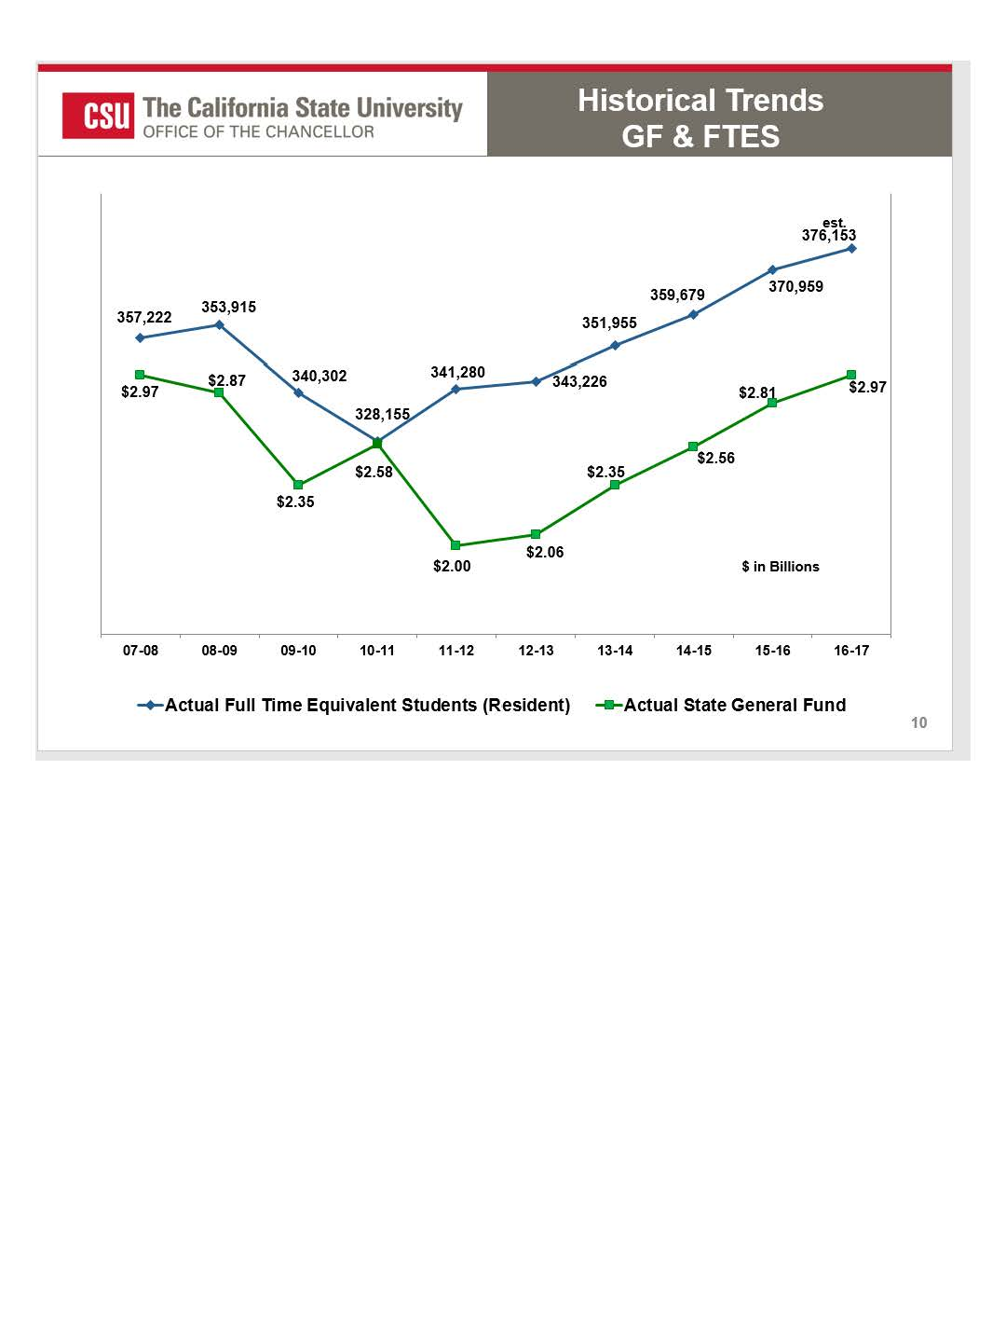

Slide 3
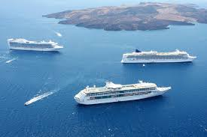
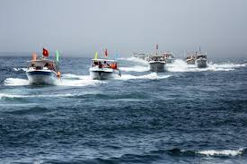
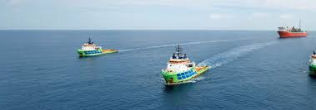
Question 1: WHERE is the money coming from?
Fund = Ship (within a family of ships)
BK=State Funds SP=Sponsored Program Funds MU=Non Mandatory Fee Funds

Slide 4
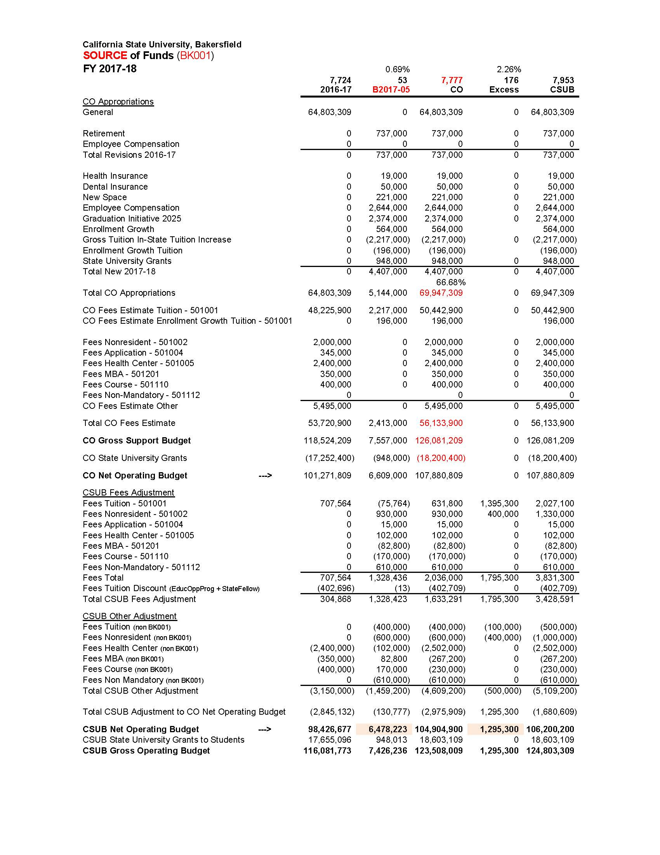

Slide 5
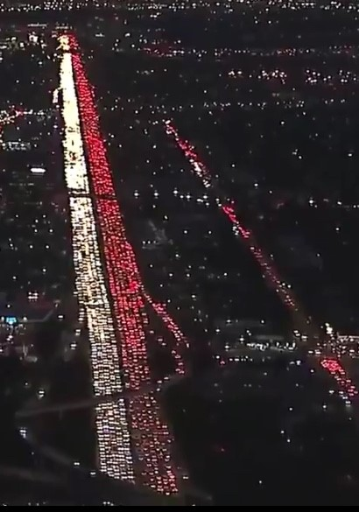
BK001 (I-5)

Slide 6
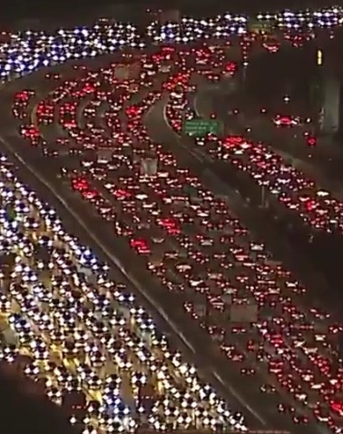
BK002 … and other priorities (I-5 on ramp)

Slide 7
Reminders:
Tenure-track density as compared to CSU
Student/Faculty Ratio as compared to CSU
Salaries and Benefits @ 90%

Slide 8
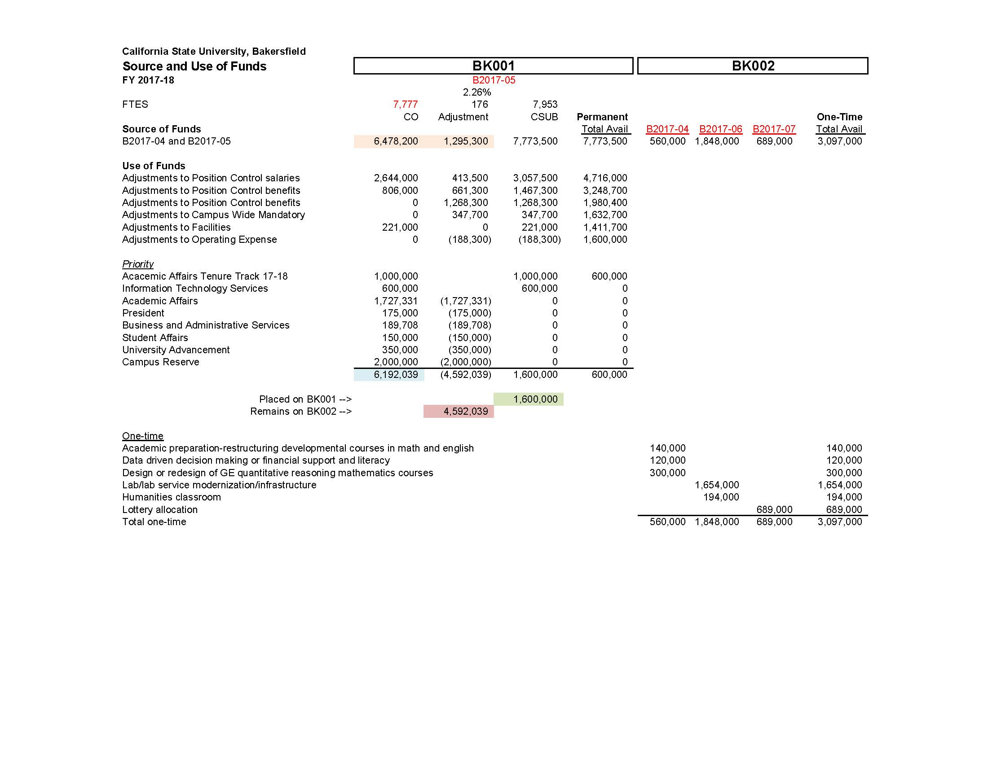

Slide 9
