Slide 1
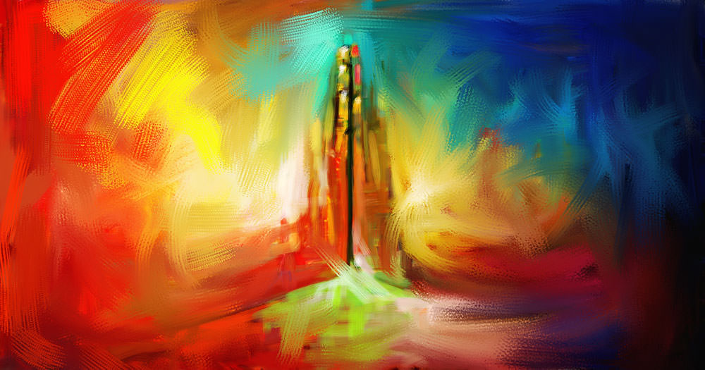


INTERNATIONAL COFFEE HOUR
WELCOMES YOU TO
INDIA
PRESENTERS:
ALEKHYA KOTHARU
DEEPSHIKHA BALASUBRAMANIAN

Slide 2
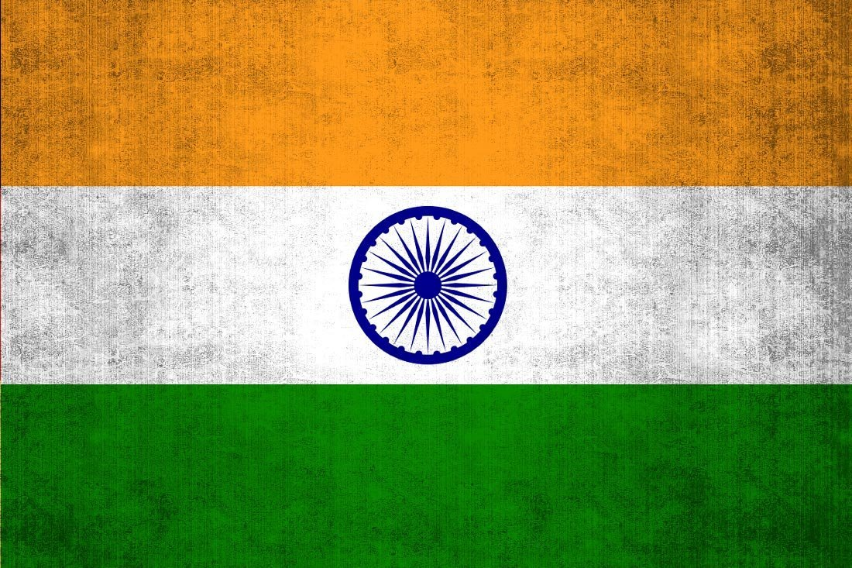
INDIA
IS MY COUNTRY
AND ALL INDIANS ARE MY BROTHERS AND SISTERS…

Slide 3

WE WOULD LIKE TO SAY A FEW WORDS…
We are thankful for the opportunity
And Glad that many of you are here today…
We are neither professional speakers nor experts
Talk is based on our personal observations
Errors and mistakes are our own
We are from South India.
We speak languages called Tamil and Telugu.

Slide 4
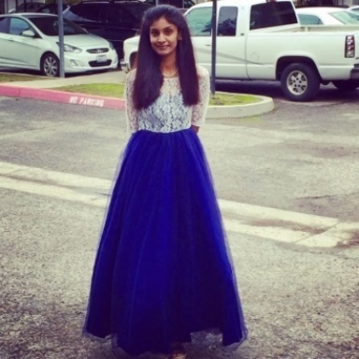
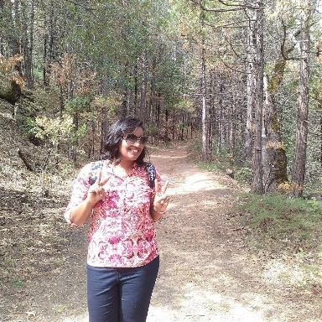
A Little About Us…
ALEKHYA
KOTHARU
Born and raised in Hyderabad(India)
Mother tongue : Telugu
In the US since 2014
Raised in India till 21
Bachelors in Computer Science.
Master’s in Industrial Technology.
DEEPSHIKHA
BALASUBRAMANIAN
Born in Pondicherry(India) and raised in Bangalore (India)
Mother tongue: Tamil
In the US since 2016
Raised in India till 22
Bachelor’s in Electronics and Communication Engineering
Master’s in Computer Engineering

Slide 5
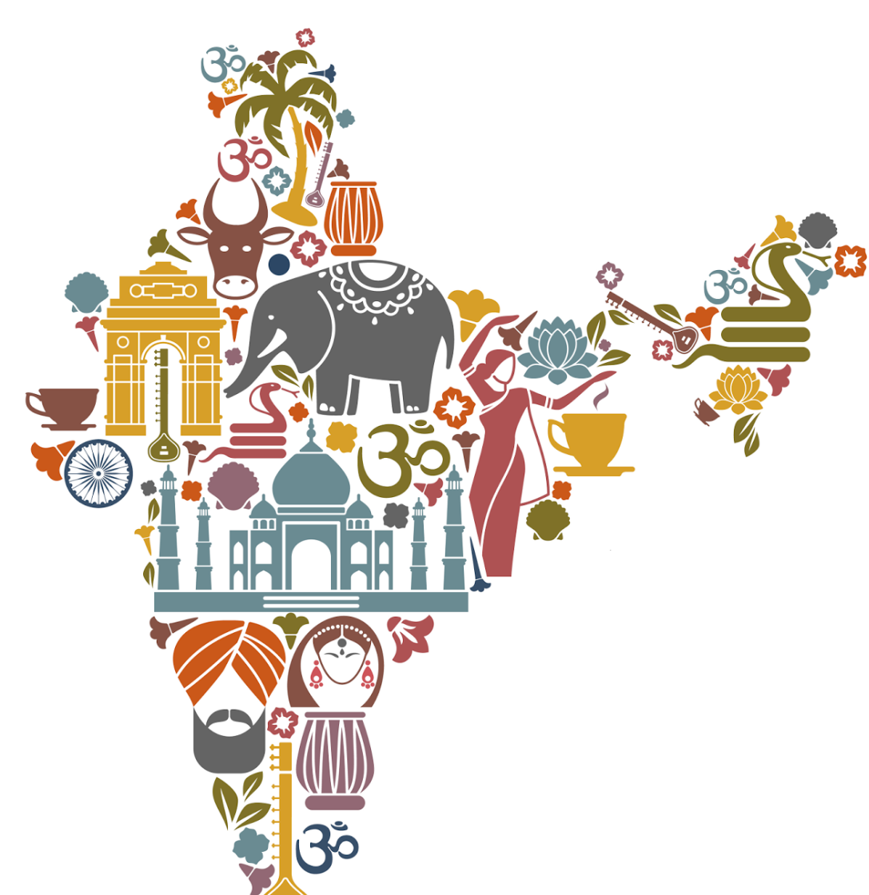
What comes to your mind when we say INDIA?

Slide 6
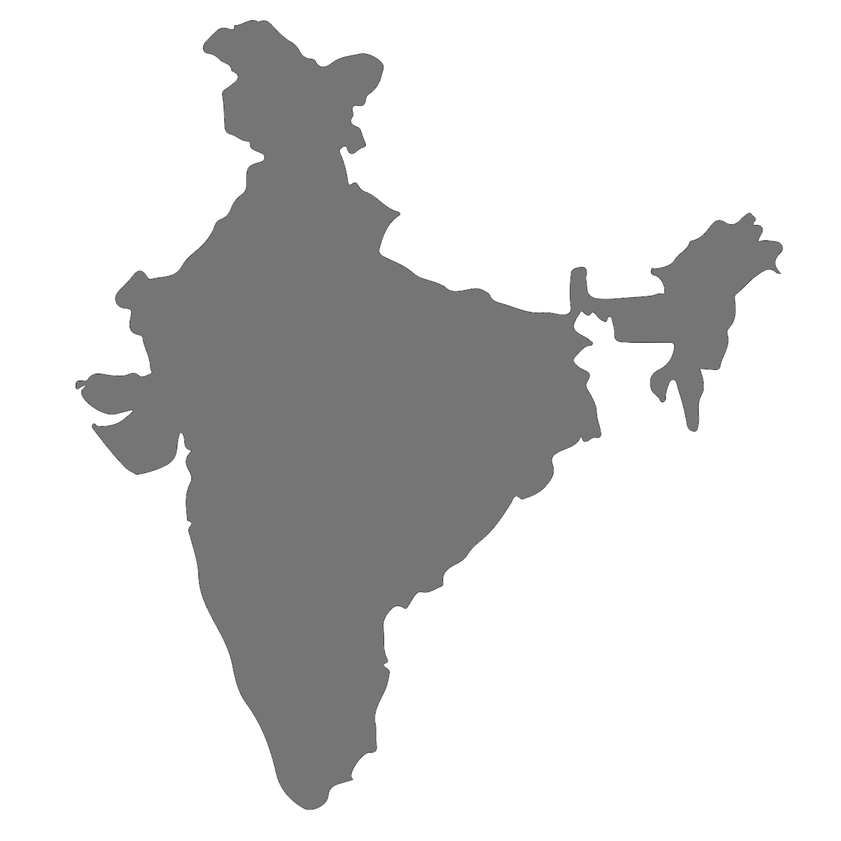
Our Country…
India (Bharat)
Capital : New Delhi
Location : South Asia
Currency : Indian Rupees (INR)
29 states and 7 union territories
Languages : 23 constitutionally recognized official languages
Largest democracy in the world
One of the Oldest Civilizations : Indus valley, Mohenjodharo and Harappa
7th largest country (by area)
2nd most Populated Country ( about 1.2 billion)
  ~1/3 US size
  ~3 time more people
Himalayas in North
Indian Ocean (S), Bay of Bengal (E) & Arabic Sea (W)
Neighbors : Sri Lanka (S), Myanmar & Bangladesh (E), Nepal, Bhutan, & China (N), & Pakistan & Afghanistan (W)

Slide 7
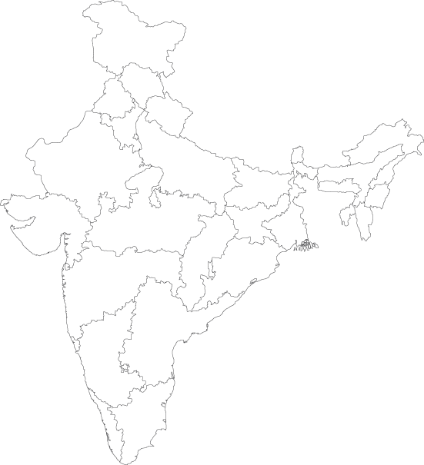
A Few Facts …
Country so diverse in geography, culture, tradition and way of life.
Many spoken languages, 23 being official
Religious beliefs : Hinduism , Christianity, Islam, Jainism, Buddhism, Sikhism, Jhatt, Jewism.
Former colony of British, Gained independence on August 15th 1947
World’s largest Democracy, Largest parliament and the longest Constitution.
Nation Symbols:
  Flag : the tricolor flag
  Animal : tiger
  Bird : peacock
  Flower : lotus
  Fruit : mango
Mohandas Karamchand Gandhi (or) Mahathma Gandhi referred as Father of Nation.
Since there are too many region, languages and culture, we recognize regions North and South India.

Slide 8

Let’s take a closer look on…
SOUTH INDIA

Slide 9
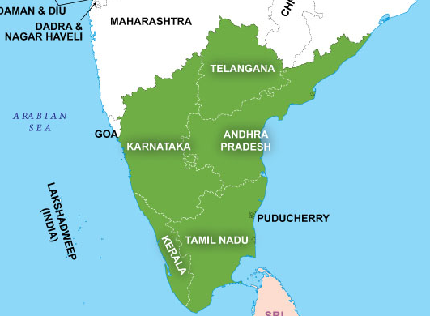
Geography
5 states :
  Andra Pradesh
  Karnataka
  Kerala
  Tamil Nadu
  Telangana
And 3 Union terrirories :
  Pondicherry
  Andaman & Nicobar islands (bay of Bengal)
  Lakshadweep islands (Arabian Sea)
Major cities :
  Chennai
  Bangalore
  Hyderabad
  Thiruvanathapuram (or) Trivandrum
  Vishakaptnam
  Cochin (or) Kochi

Slide 10
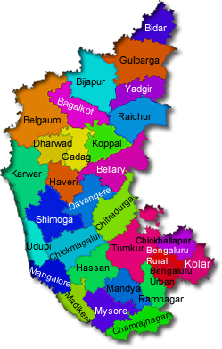
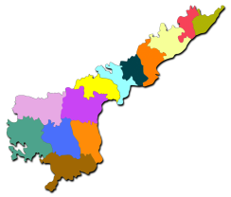
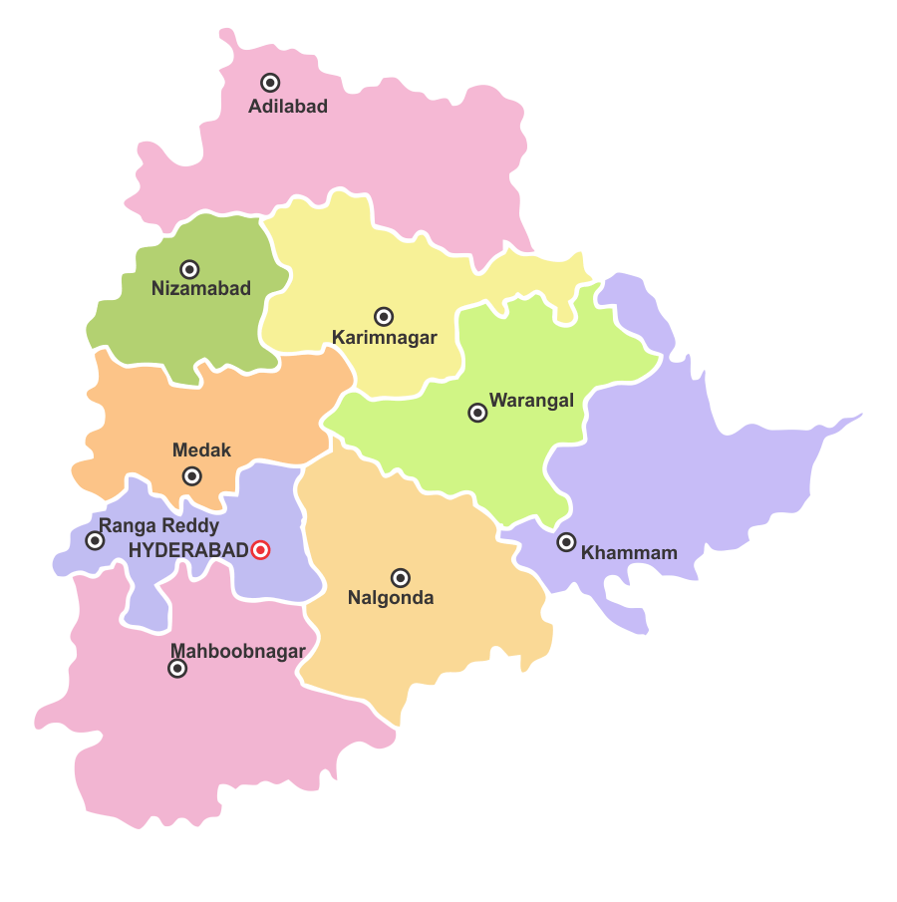
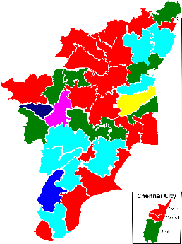
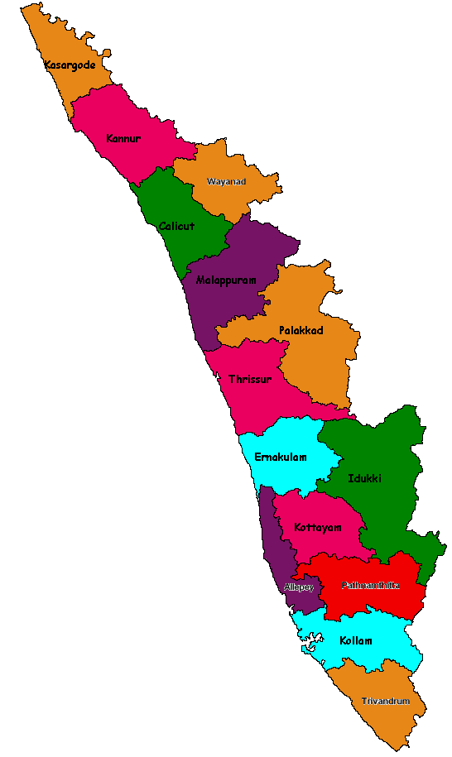
A few more facts…
ANDRA PRADESH
Capital : Amaravathi
Spoken language : Telugu (తెలుగు)
Famous places : vishakapatnam (port), tirupathi (tourist and pilgrim site)
Famous for cuisine and temples
KARNATAKA
Capital : Bangalore (Silicon valley)
Spoken Languages: Kannada (ಕನ್ನಡ)) , thulu
Famous places : Mysore (tourist site), Mangalore, Coorg (Kodagu)
Famous for Sandal wood and products
KERALA
Capital : Trivandrum
Spoken language : Malayalam (മലയാളം)
Famous places : Cochin (port), Calicut (Kozhikode)
“God’s own country”
Famous for cuisine, scenic beauty
TELANGANA
Capital : Hyderabad
Spoken language : Telugu (తెలుగు)
Recently formed state
Famous for Nizam’s style cuisine
TAMIL NADU
Capital : Chennai
Spoken language : Tamil (தமிழ்)
Famous cities : Madurai, Coimbatore
Famous for cuisine, film industry, sarees, and temples.

Slide 11
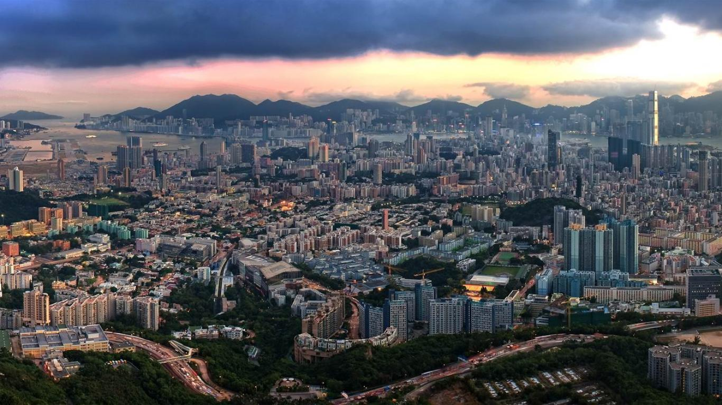
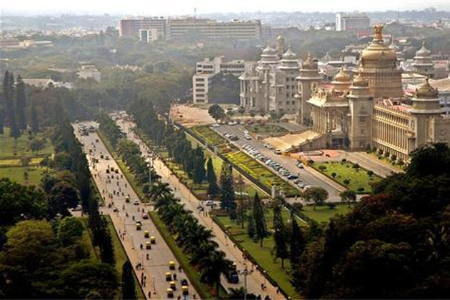
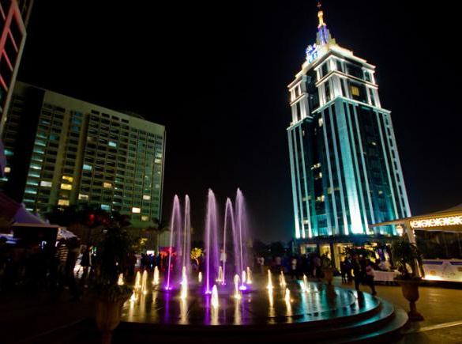
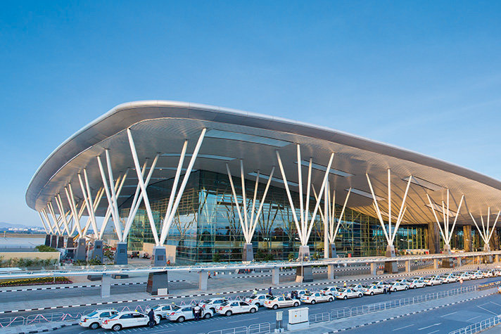
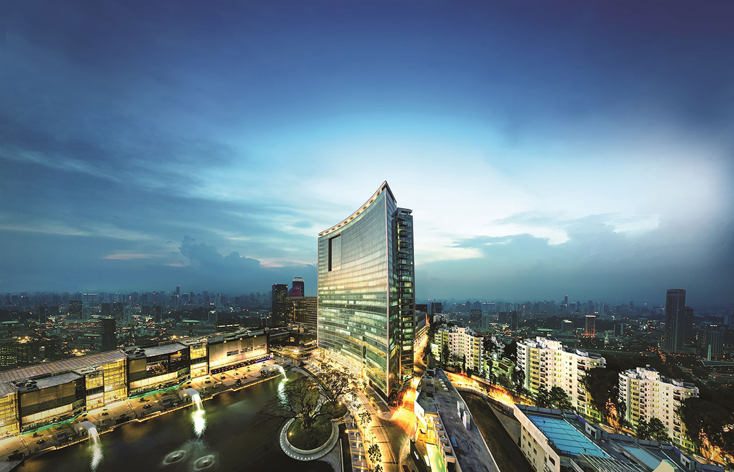
BANGALORE

Slide 12
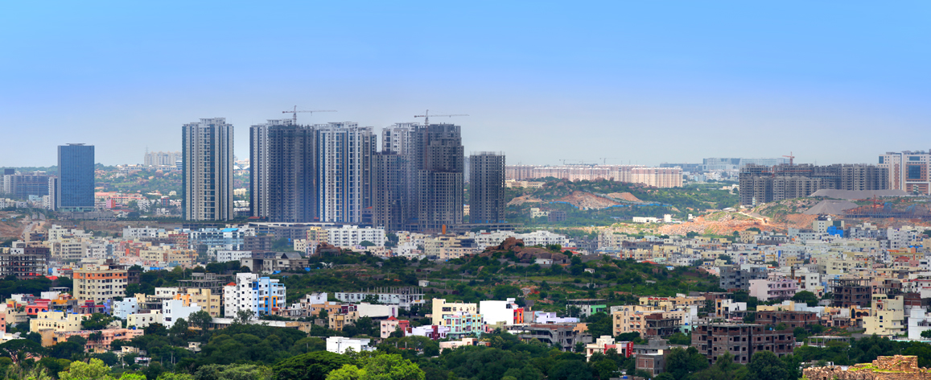
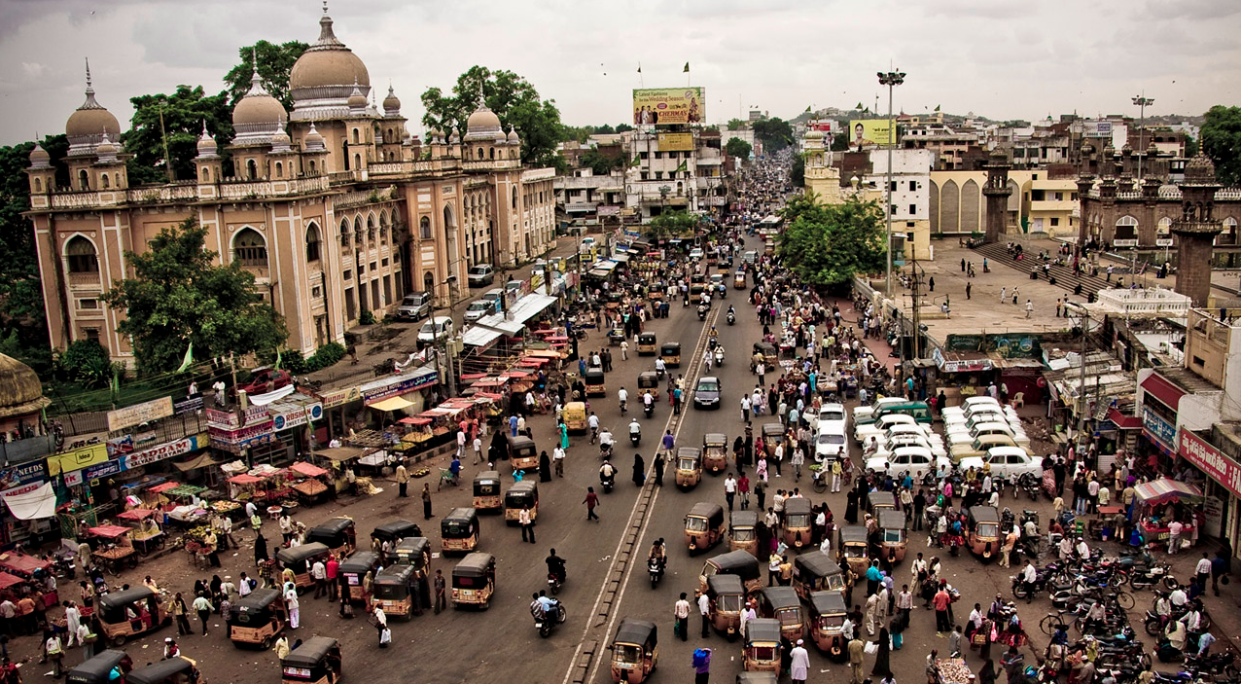
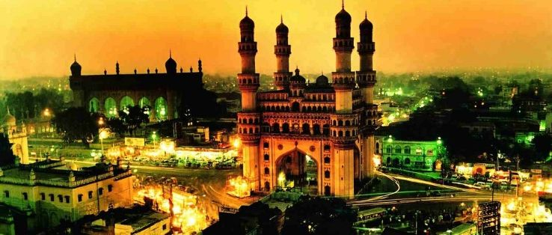
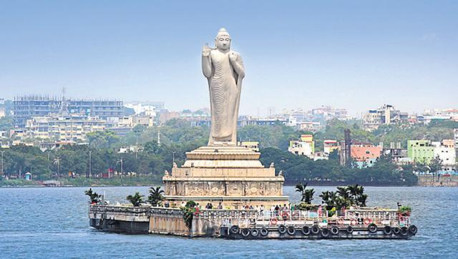
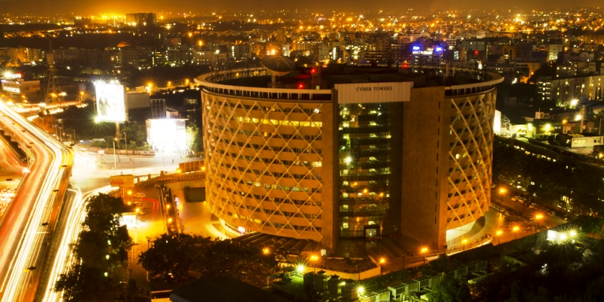
HYDERABAD

Slide 13
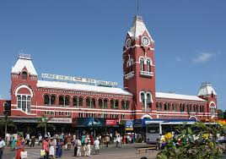
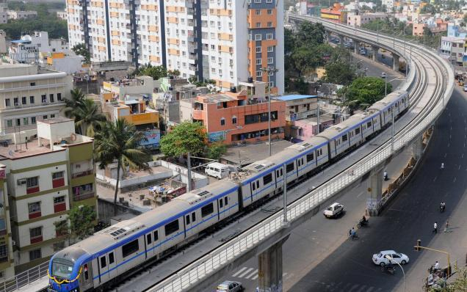
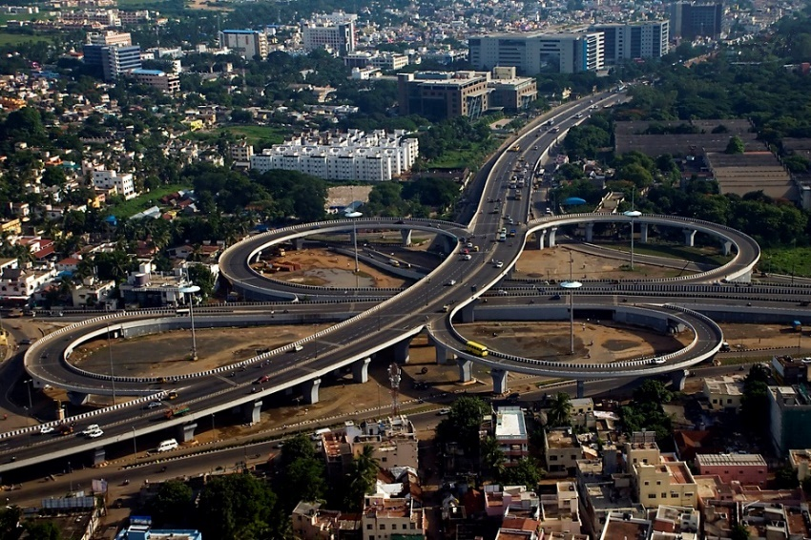
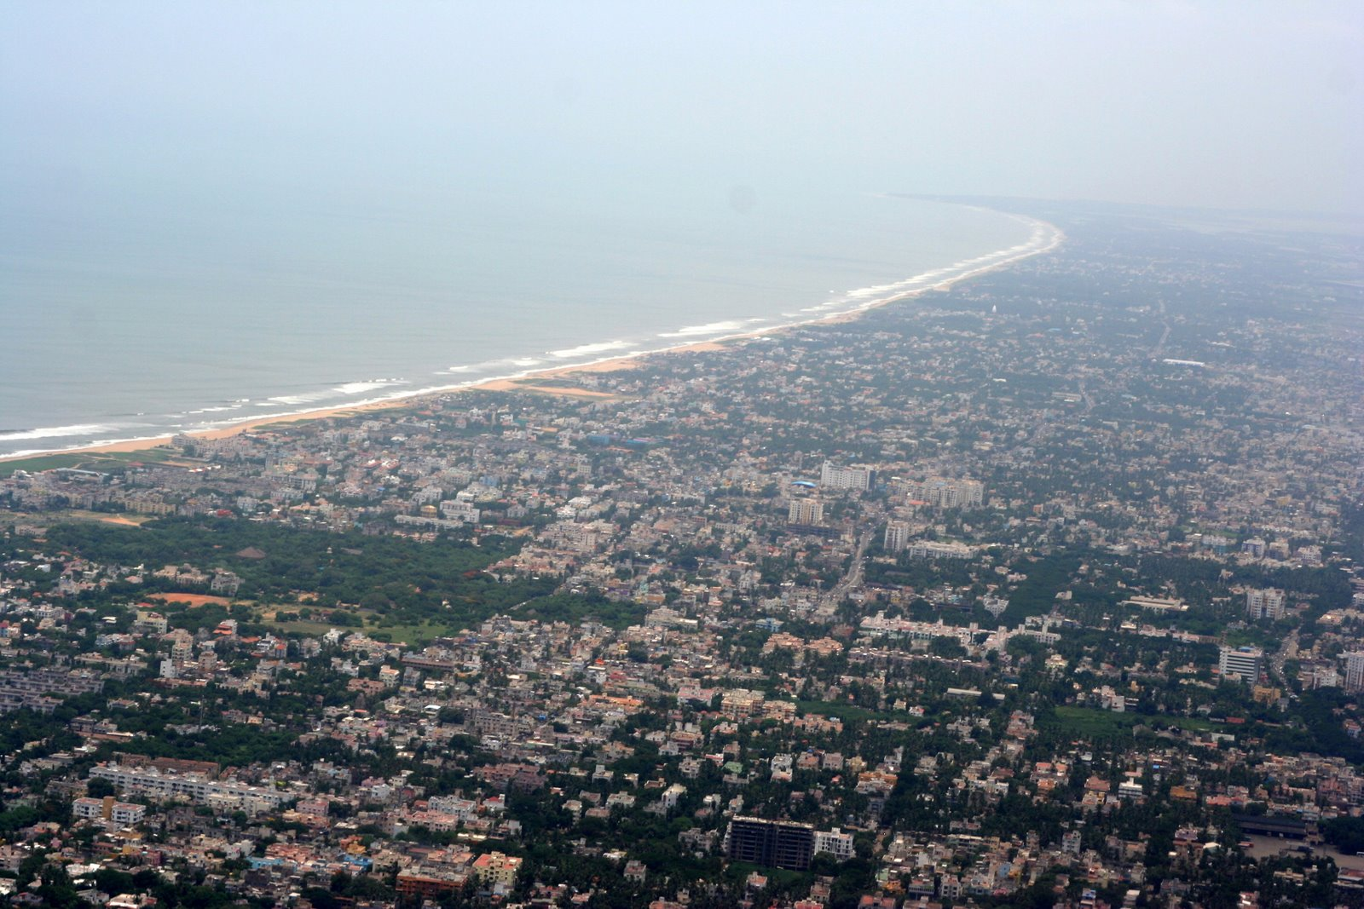
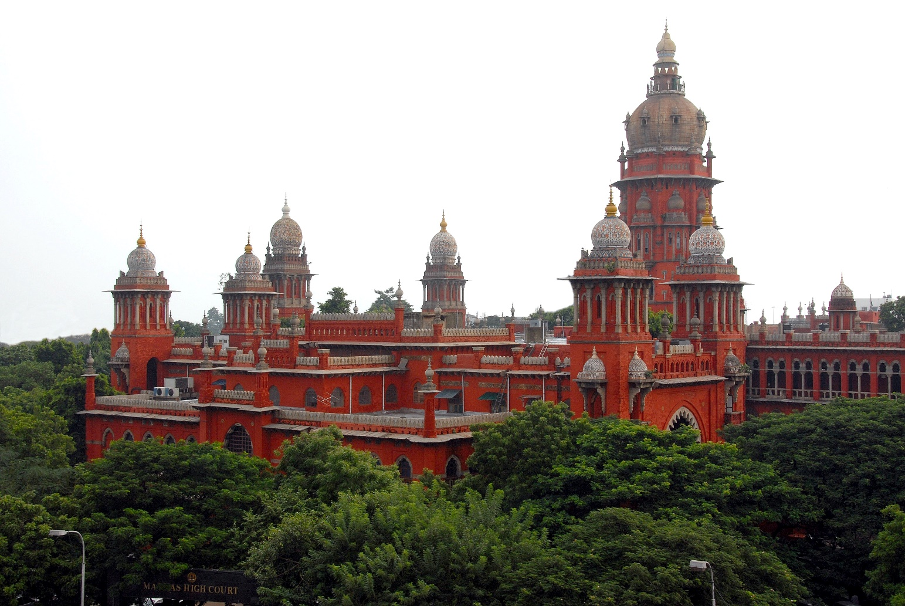
CHENNAI

Slide 14
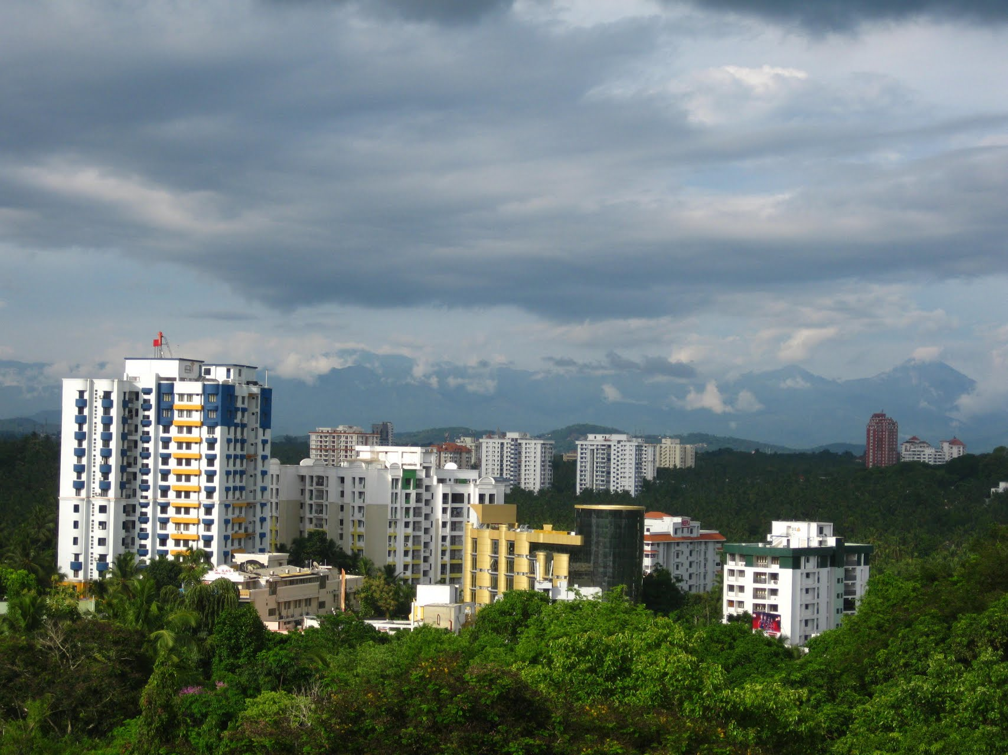
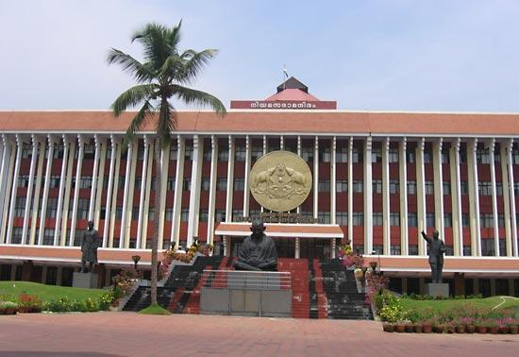
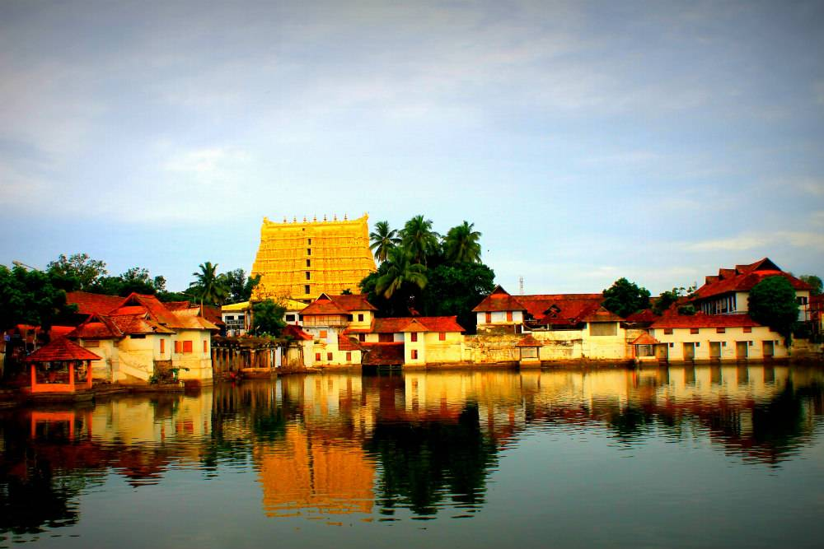
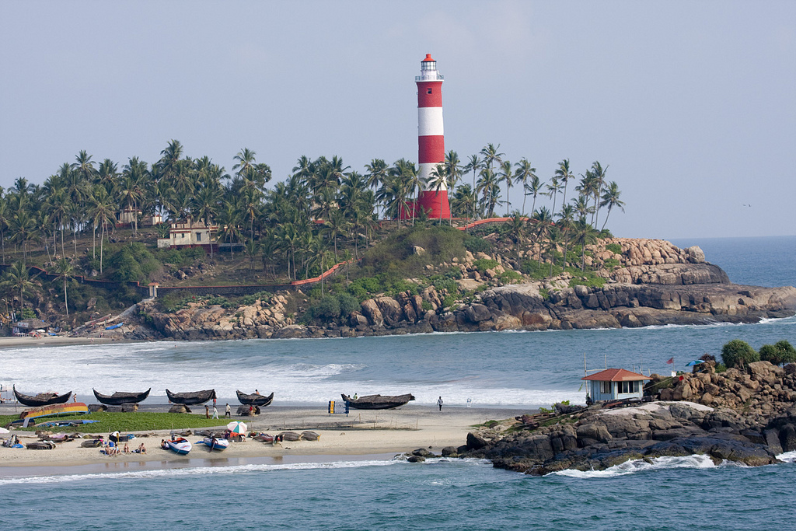
TRIVANDRUM

Slide 15
WHAT ARE WE FAMOUS FOR ?
LANGUAGES
HISTORY
ARCHITECTURE
FOOD AND CUISINE
DRESSING
WEDDING
DANCE AND ART FORMS
CARNATIC MUSIC

Slide 16
LANGUAGES
Major languages are Tamil (தமிழ்) , Telugu (తెలుగు), Kannada (ಕನ್ನಡ) and Malayalam (മലയാളം)
Tamil :
  oldest language in the world which is still being spoken
  Language and literatures date back 3000 B.C
  Also known as the language of the Dravidians
Telugu :
  Language spoken majority of the population
  Literatures dates back to 500 A.D
  Language originated from Sanskrit and Tamil
Kannada :
  Spoken in the regions of Karanataka
  Language orginated from Sanskrit
  Literature dates back to 230 B.C
Malayalam :
  Spoken in the regions of Kerala
  Originated from Tamil and Sanskrit
  Literatures date back to 13th century
There are languages are spoken by a few minor communities like Tulu, Konkani, Baduga

Slide 17
HISTORY
Regions of south India were famous all around Europe and Southeast Asia for trading Spices, precious gems like diamond, ruby and emerald and Silk during 3rd century (times of Iron Revolution)
These regions were ruled by many great dynasties like Cheran (regions of Kerala ), Cholan, Pallavas and Pandian (regions of Tamil Nadu), Satvahana, Rashtrakutas and Chalukyas (regions of Karnataka) and vijayanagara (regions of Andra and Telanga)
Europeans (French, Dutch, Portuguese) and British came in for trading spices and later Colonized in 1600s, which was very much opposed the Indian rulers
Cities like Chennai (formerly known as Madras) and Mysore were British provinces
Pondicherry was French colony
places like Calicut and Goa were Colonized by the Portuguese

Slide 18
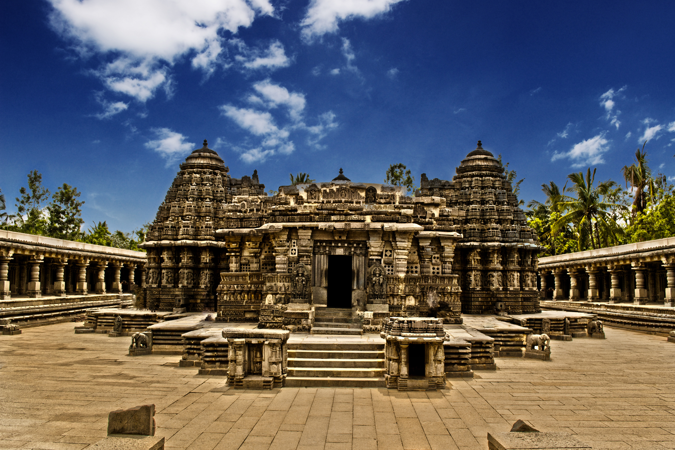
ARCHITECTURE
SKILLED, UNIQUE AND MESMERIZING…

Slide 19
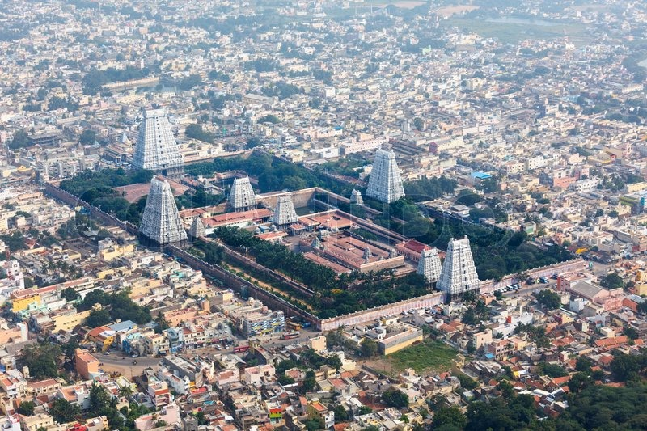
Sri Rangam Temple
Built by the Pandians
Situated in Trichy(Thiruchirapalli) – Tamil Nadu
Uniqueness : World’s Second largest Temple

Slide 20
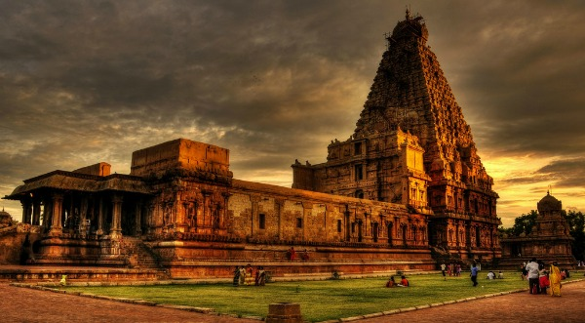
Brihadeeshwara temple
Built by Rajaraja Cholan of the Chola dynasty
Situated in Tanjavur – Tamil Nadu (capital of Chola dynasty)
Uniqueness : tallest Gopuram in the world

Slide 21
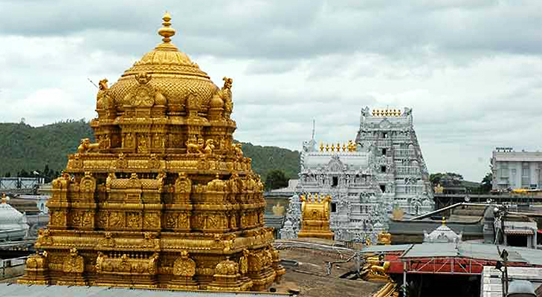
Tirupathi temple
Built by the Vijayanagara Dynasty
Situated in Tirupathi – Andrapradesh
Uniqueness : the richest temple in the world and gets the most number of visitors

Slide 22
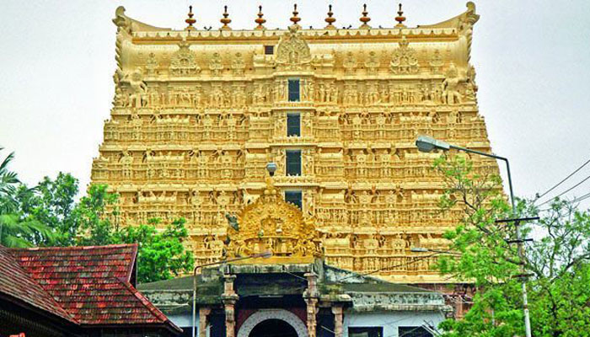
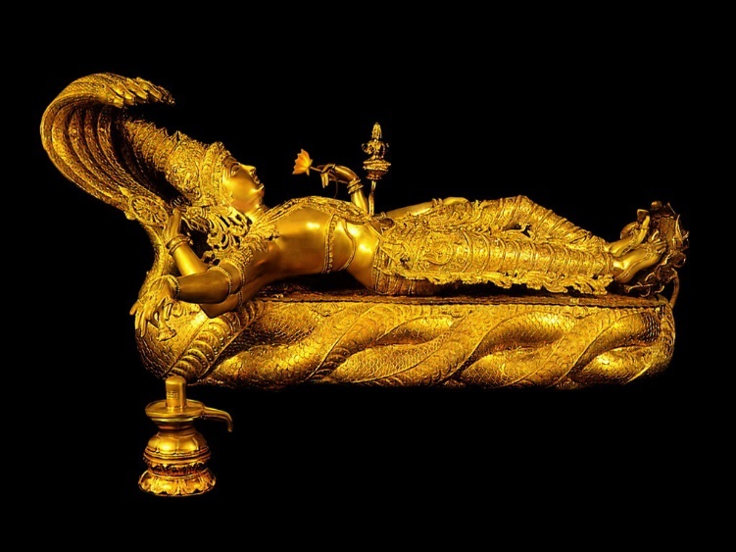
Ananthapadmanabhaswamy temple
Built, owned and maintained by the Travancore (tiruvangoor ) dynasty
Situated in Tiruvananthapuram – Kerala
Uniqueness : the temple that inherited the richest treasures and main idol is made entirely of gold

Slide 23
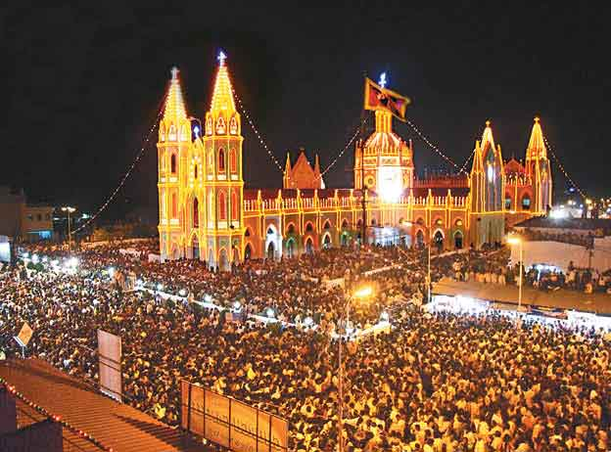
Velakankanni church
Popularly known as Church of south India.
Built by the Dutch
Situated in Velankanni – Tamil Nadu
Uniqueness : largest and most visited church

Slide 24
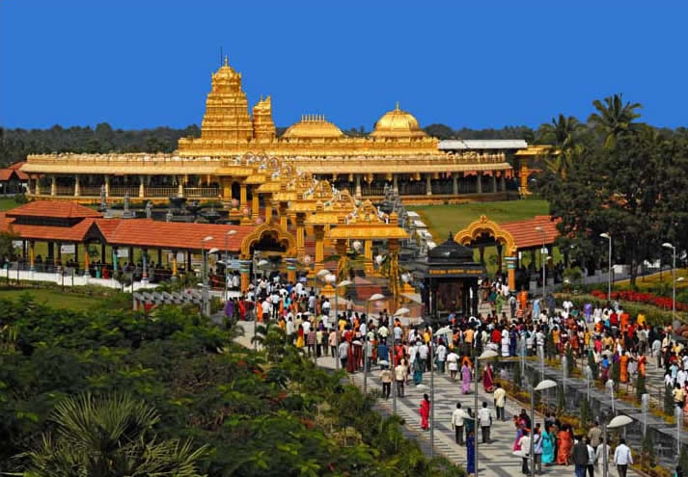
The Golden temple - Vellore
Built about 10 years ago
Situated in Vellore – Tamil Nadu
Uniqueness : temple is entirely made out of gold

Slide 25
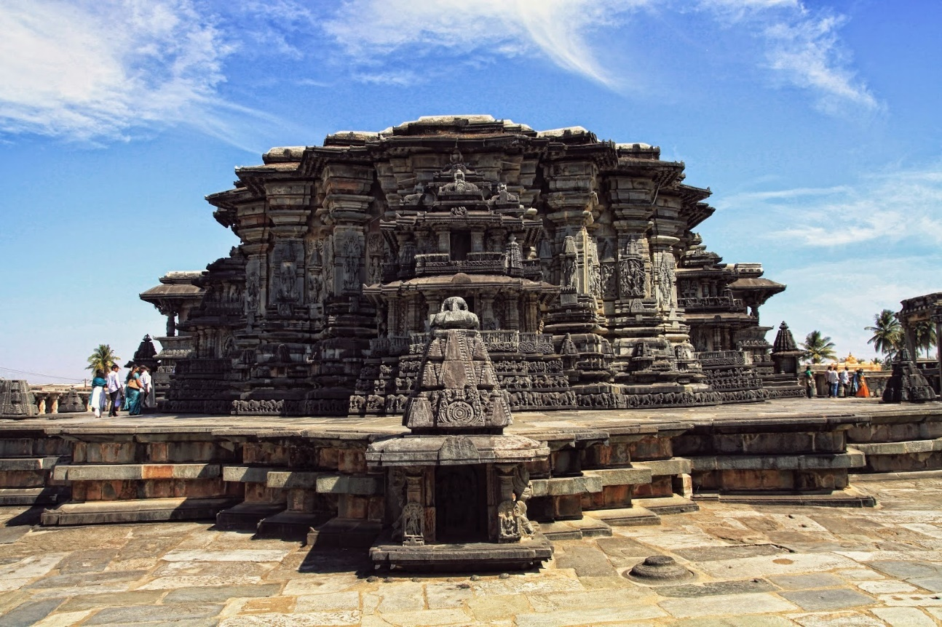
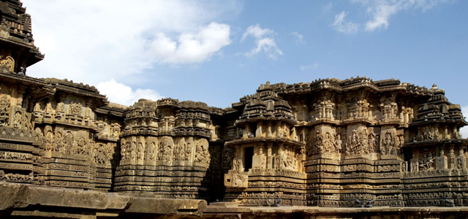
Belur and Halibeedu
Built by Chalukya dynasty
Situated in Karnataka
Uniqueness : the sculptures and architectural beauty

Slide 26
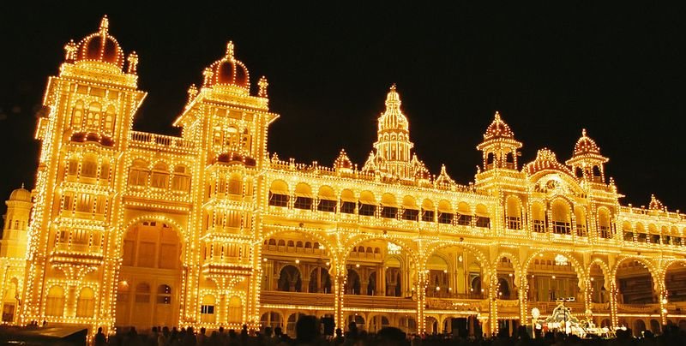
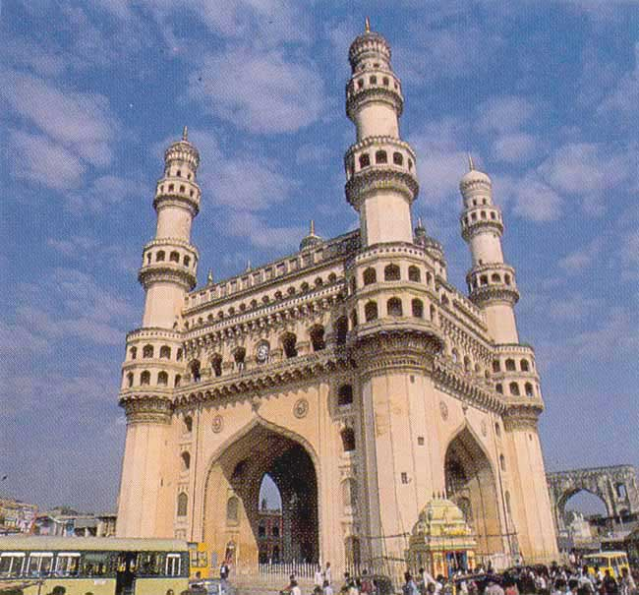
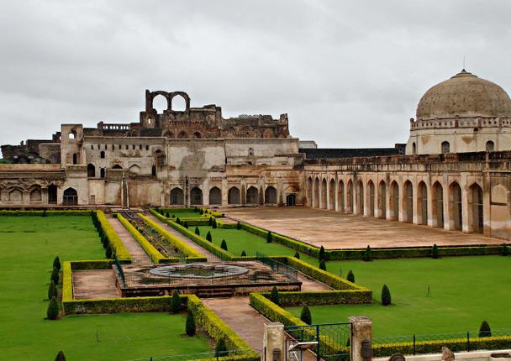
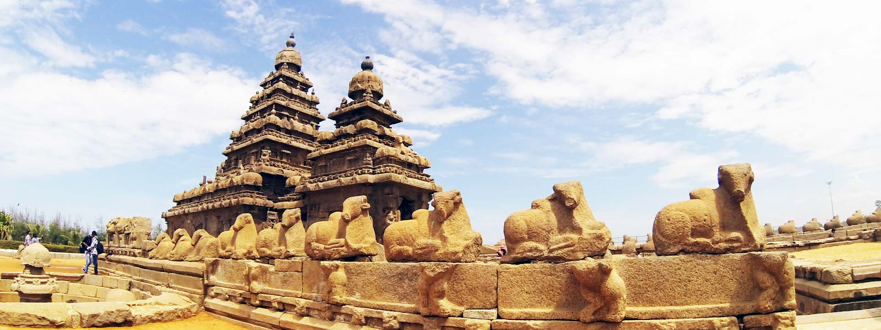
Mysore palace
Charminar - Hyderabad
Bidar fort
Mahabalipuram (mamallapuram)

Slide 27
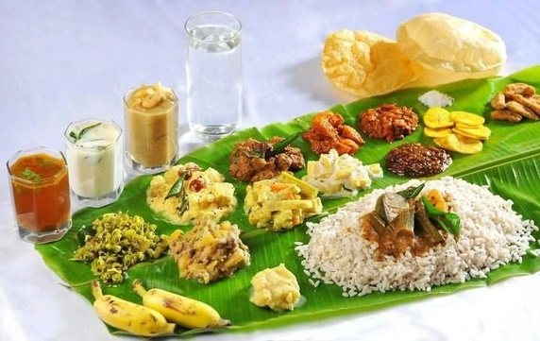
FOOD AND CUISINE

Slide 28
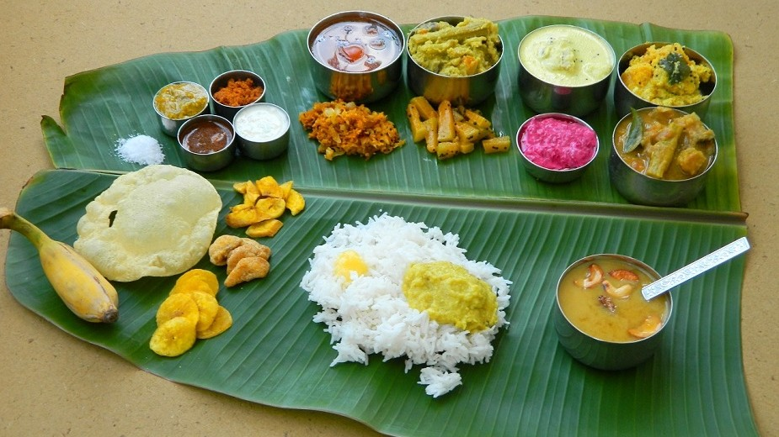
Yes… We do eat our meals on a Plantain leaf!
Or in copper or silver ware
Our food is cooked in earthen pots or copper utensils
Most of us are vegetarians (about 70 %)
Our food is mostly proteins and carbohydrates – Rice, Grams, millets and Lentils
Most of cooking include coconut, tamarind and chilies.
South Indian cuisine use a lot of spices to make it tasty and healthy
All our sweet delicacies are made of milk, milk products, nuts and dry fruits.

Slide 29
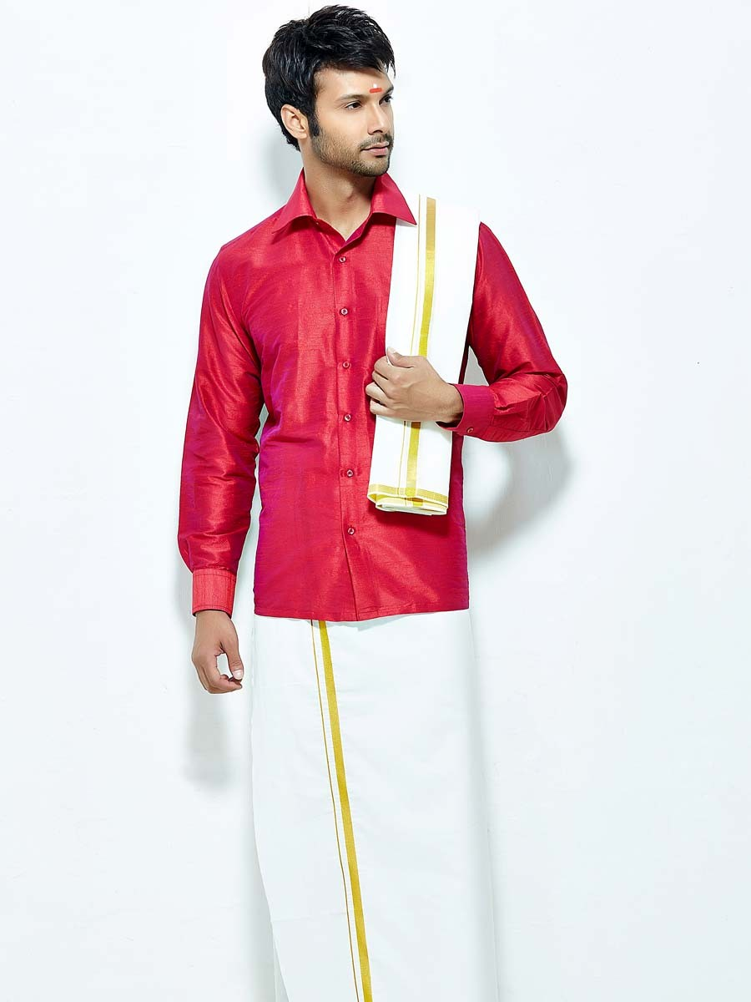
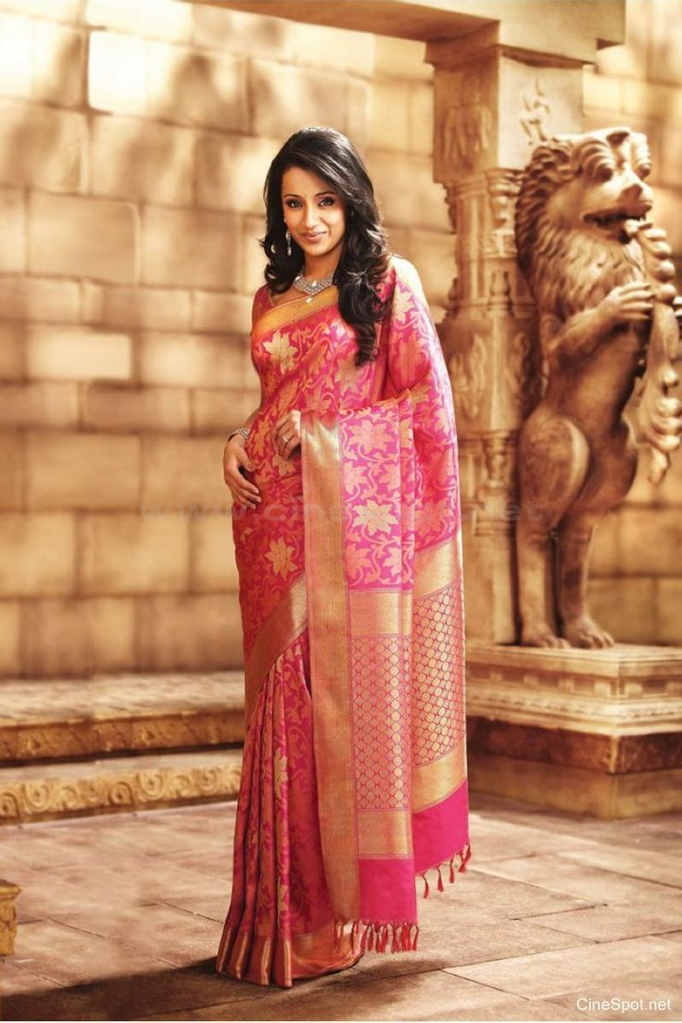

DRESSING
Men : Shirt And Dhothi
(veshti sattai)
Women : Saree
(Seere Or Selai)
Children : Skirt and blouse
(pavadai sattai)

Slide 30

Talk about our obsession with …
GOLD JEWELERY

Slide 31






Our attire is never complete without gold jewelry!

Slide 32

WEDDINGS

Slide 33

  Indian weddings are “ARRANGED MARRIAGES”
  Stages of wedding :
    How do we find the bride and groom?
    Engagement
    Preparations for the wedding
    The wedding - Muhurtham
    Post wedding celebrations
  On an average about 2000 guests on the occasion
  South Indian weddings last up to 5 days

Slide 34






Bride and groom family meet
Engagement
Wedding
Toe ring ceremony
Post wedding rituals
Muhurtham – tying the holy thread

Slide 35

ART

Slide 36




MURALS THAT ARE FOUND IN ALL TEMPLES
TANJORE ART
PAINTINGS WITH 24CARAT GOLD
RAJA RAVI VARMA PAINTING
OF INDIAN WOMEN
STATUE OF NATARAJA –
MADE OF 5 METAL ALLOY

Slide 37

DANCES

Slide 38





KUCHIPUDI
ANDRA PRADESH
MOHINIATTAM - KERALA
YAKSHAGANA
KARNATAKA
KATHAKALI - KERALA
BHARATHANATIYAM
TAMIL NADU

Slide 39

MUSIC

Slide 40
South indian classical music is called as Carnatic Music
Has 7 fundamental notes : SA RE GA MA PA DA NI
Combination of these 7 notes make Raagam (tune)
And Raagam combined with Thalam (Scale) gives the Music
There are 73 basic Raagam and 7 Thalam
South Indian Music usually employ instruments like Flute, Violin, Veena, Mridhangam, Sitar
Renowned Carnatic musicians are M.S.Subhalakshmi, Muthuswamy Dixitar, Thagarajar…

Slide 41





MRIDHANGAM
TABLA
FLUTE
M.S.SUBHALAKSHMI
CARNATIC SINGER
RECIEVER OF HIGHEST CIVILIAN AWARD
BHARATH RATNA
VEENA

Slide 42

FESIVALS AND CELEBRATIONS

Slide 43









DASARA & NAVARATHRI:
First 9 days are called Navrathri – celebrates 9 forms of Godesses
10th day is called Dasara – celebrates the Return of Lord Ram
SANKRANTHI (or) PONGAL
Harvest festival
Celebrated by and for the farmers
Called as Sankranthi in telugu and kannada
Called as Pongal in tamil
Last for 3 days
First day honours the Sun god
Second day honours the farmers and the cattle
DIWALI
usually falls during the month of October
Festival of lights
Celebrating the destruction of Evil
VISHU & TAMIL PUTHANDU
April 14th
New year for the Tamil and Malayalam speaking
UGADI
New year for Telugu and Kannada speaking
Falls on new moon day during the month of march-april

Slide 44
FAMOUS
PERSONALITIES

Slide 45

Dr. A P J Abdul Kalam
15 October 1931 – 27 july 2015
Rameshwaram – Tamil Nadu
Former President of India
Scientist, teacher, visionary
Receiver of the highest civilian award BHARAT RATNA
Most loved citizen
15th October is declared as – World Science Day by UNO to Honor Dr.Kalam

Slide 46

C V Raman
Sri Chandrashekhar venkata raman
Physicist
Thiruchirapalli – Tamil Nadu
Research on Raman Spectrum
Started the India Institute of Science – Bangalore
Awarded with Nobel prize for Physics

Slide 47

Srinivasa Ramanujam
Mathematician
Madras – Tamil Nadu
Remembered for his contributions in mathematics
Was able to compute 1Million digits of ∏ (Pi)

Slide 48

Aishwarya Rai Bachchan
Bollywood Actor
Mangalore - Karnataka
Crowned Miss World 1994
Honored by the Indian Government – PADMA SRI
Termed as “ Most Beautiful woman in the World”
Appeared in Hollywood movies such as Pink Panther II, Bride and Prejudice

Slide 49

A R Rahman
Allah Rakha Rahman
Musician
Chennai – Tamil Nadu
Winner of Oscars, Golden Globe Awards, Grammy Awards and many more
Most celebrated Musician
Also known as Mozart of Madras and Isai Puyal

Slide 50
WE HOPE YOU GUYS
LIKED IT …!

Slide 51


Slide 52


