Slide 1
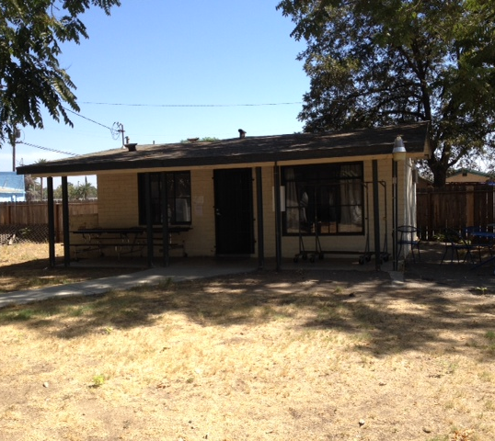
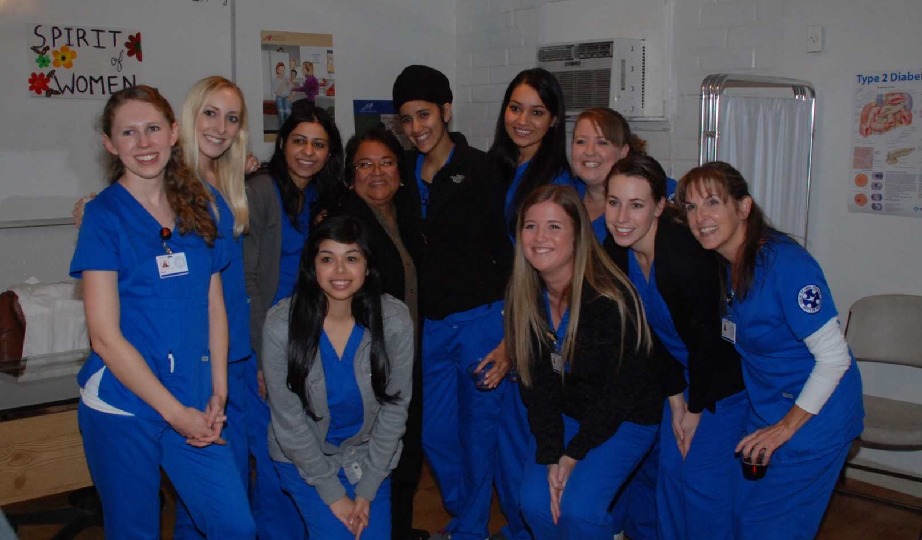
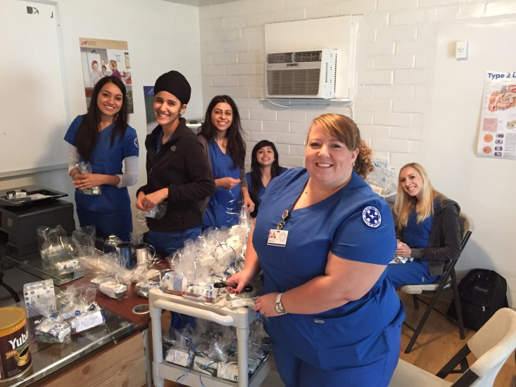
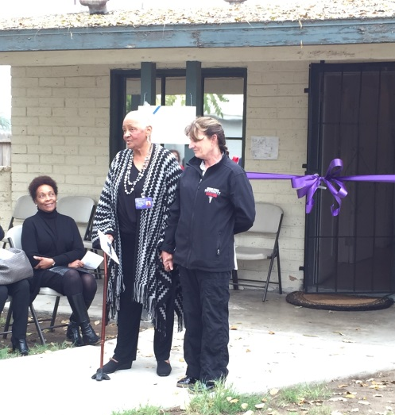
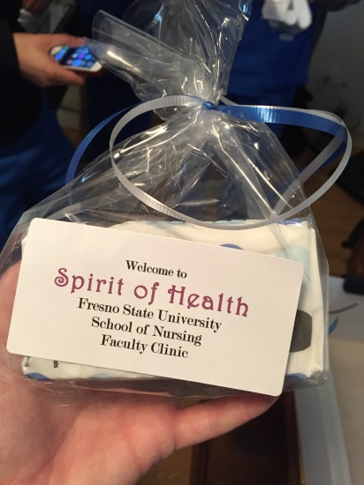
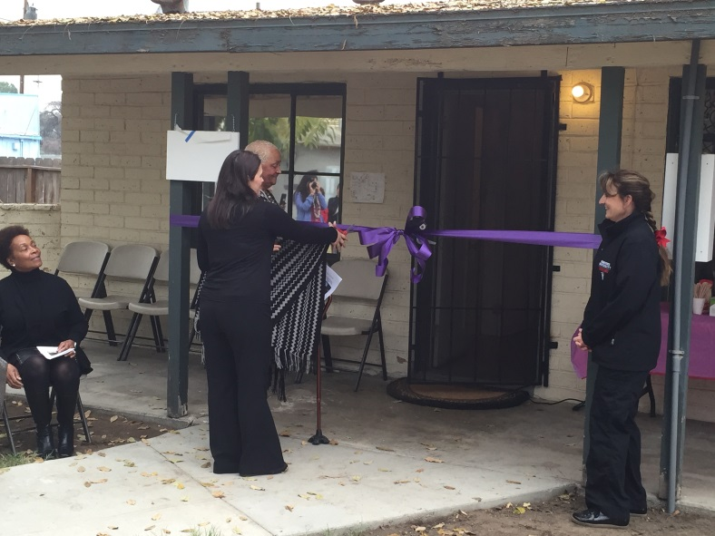
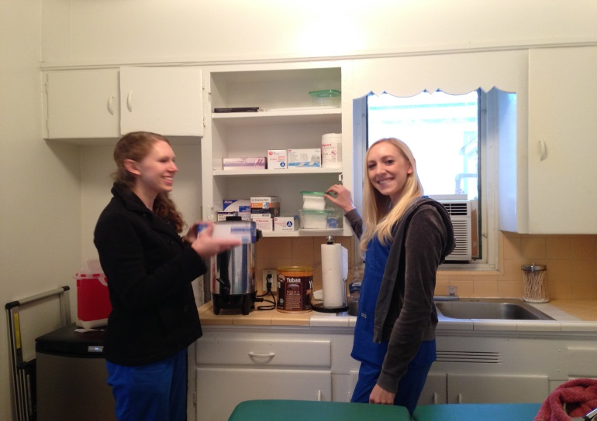
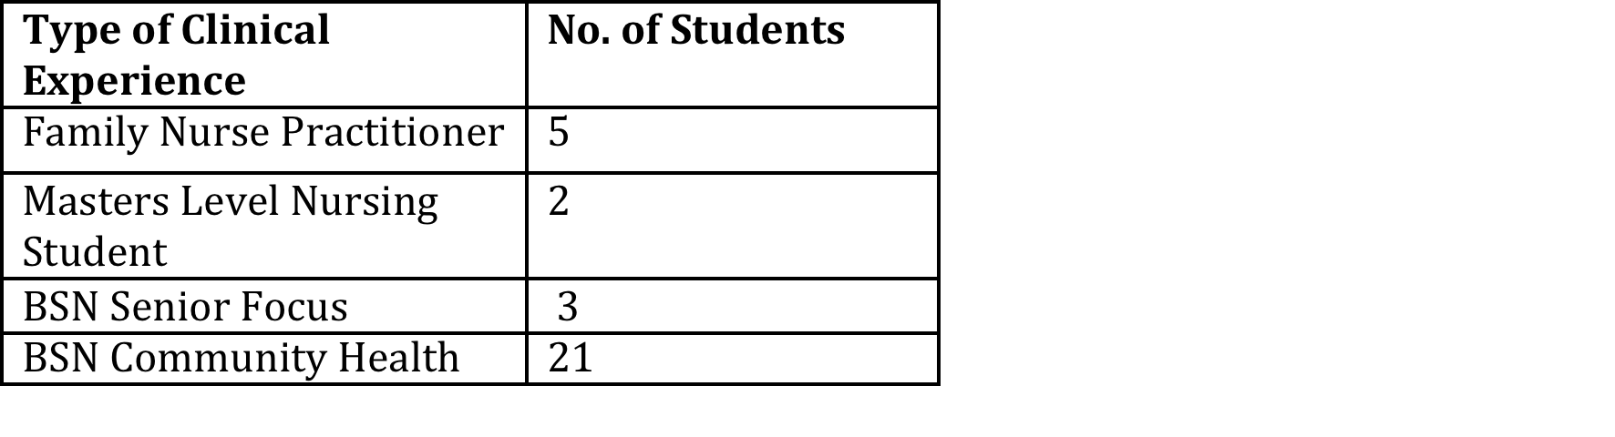
Spirit of Health-School of Nursing Presented by Kathleen Rindahl, RN, DNP, FNP-C
13 Clinic Days = 192 Client Visits
Goals:
1. Provide increased access to health care services for the clients at Spirit of Woman.
2. Training site for undergraduate and advanced practice nursing students for hands on clinic experience.
3. Service Learning education – exposure to multiple health disparities of a specific population and the needs of vulnerable populations.
4. Increase the likelihood of undergraduate and graduate nurses to practice in an underserved community.
(Study by Charles R. Drew University (2007), indicated up to 63% of nurse practitioners, who receive their clinical training in underserved communities, will practice in these communities after program completion.)
Purpose:
To provide ongoing weekly health services for primary and secondary preventative health care. Tertiary health care needs are discussed with supervising MD and referred to appropriate community health services. Services provided by Fresno State University School of Nursing.
Nurse Practitioner Students: Primary, Secondary & Tertiary
Masters Level Nursing Students
Baccalaureate Nursing students: Senior Focus & Community Health
Interdisciplinary Collaboration: is imperative to meet the many health care needs of the women participating in the recovery program.
Dietary & Nutritional Assessments: Fresno State Department of Food Science and Nutrition.
Mental Health & Drug Rehabilitation Services: Fresno State, Kerman School of Education and Development.
Child Development Assessments: Fresno State, Kerman School of Education and Development
Grand Opening
11/13/14
Current Outcomes:
Made possible by a 149,000.00 grant from Song-Brown
Background:
Spirit of Woman, located in an underserved area of Fresno, provides residential treatment programs for pregnant and parenting women in need of substance abuse intervention. Services for as many as 70 women and 105 children can be provided, making it one of the primary residential substance abuse treatment facilities for women with children in Fresno County. Those at Spirit of Women have limited access to health care, even if they do have some type of health coverage.
Transportation: Women are assigned by the court to the facility and cannot leave unless escorted by a staff member, which prevents clients attending routine MD appointments that are not medically necessary.
Trust: 95% of the women have been physically and/or sexually abused, as early as three years old, which results in them having trust issues especially towards those they do not know, so many do not seek health care for this reason alone.
Health concerns: Hepatitis, HIV infections, sexual transmitted diseases, as well as mental health disparities. In addition: poor nutrition, dental caries, vision problems, and lack of preventive healthcare for other and child. Many of the children are under immunized and are in need of routine physicals, putting them at risk for preventable diseases. Previous access to care for these clients has typically been emergency rooms for acute illnesses
Spirit of Health, increases access to care for this vulnerable population and serves to decrease the number of Emergency Room visits made by clients at SOW. The clinic allows the women and children to receive timely medical care and attention, free of cost.

