Slide 1
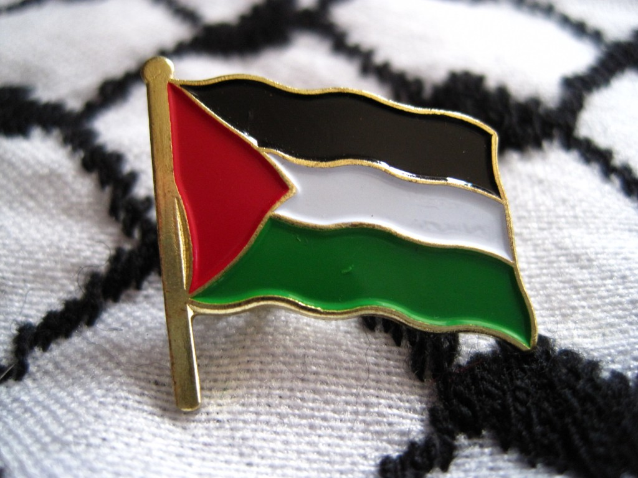
Land
The
Of
Peace

Slide 2
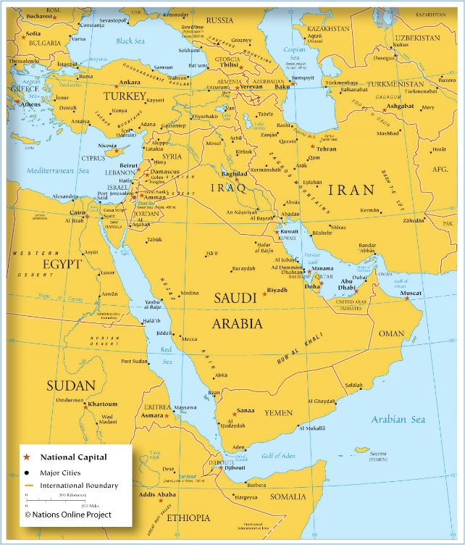

Slide 3
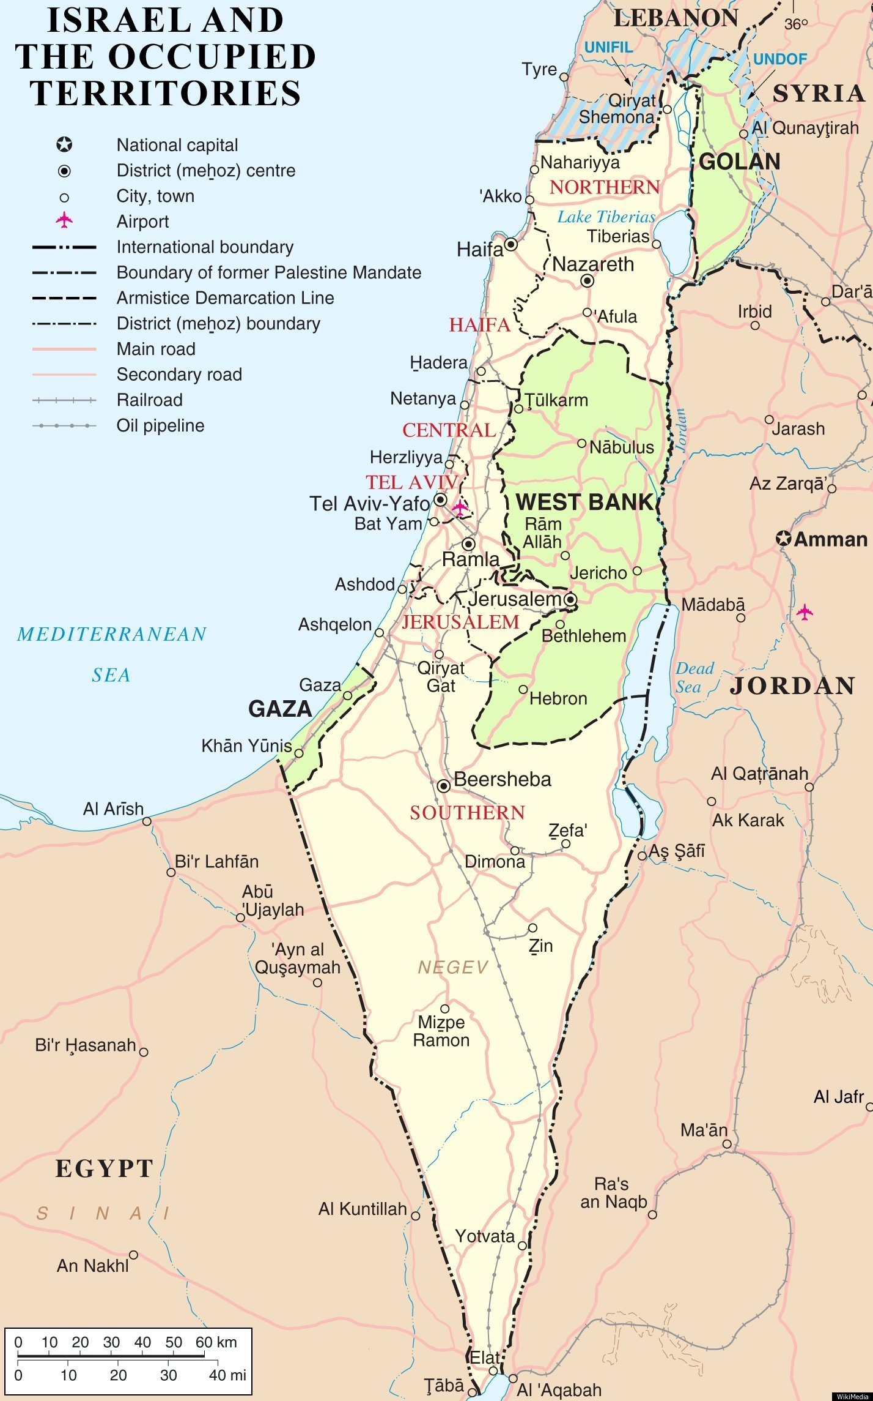
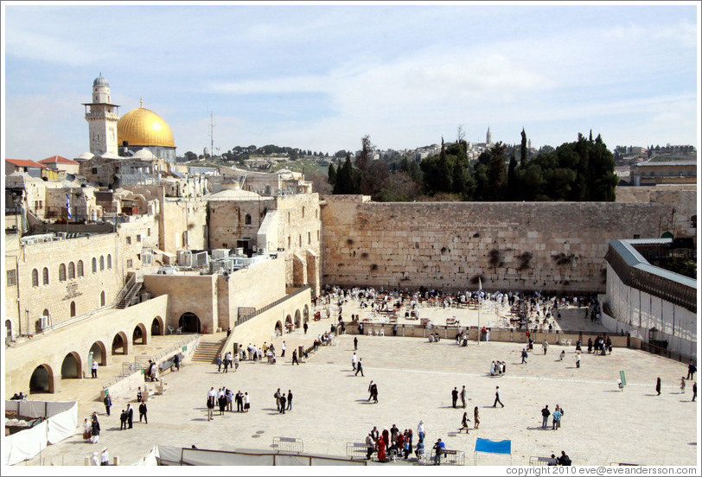
Palestine
Where Christianity was born
Where the great Jewish kingdom was established
Where Muslims have the Holy mosque

Slide 4
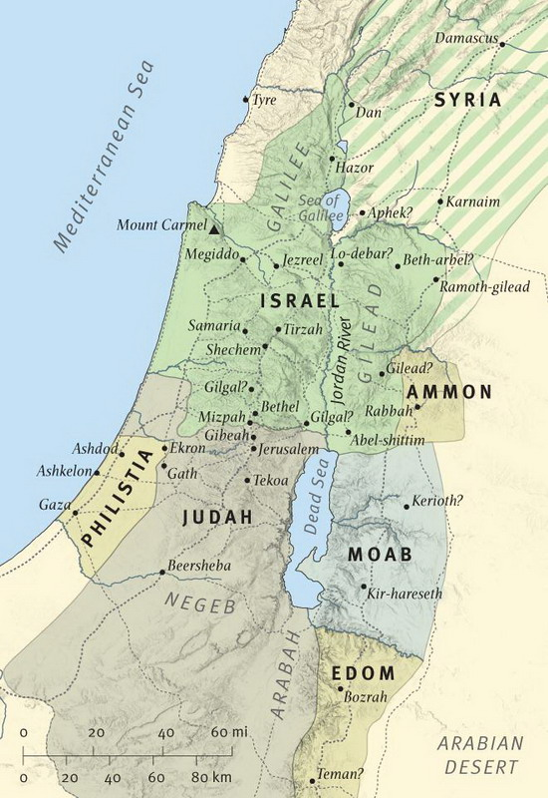
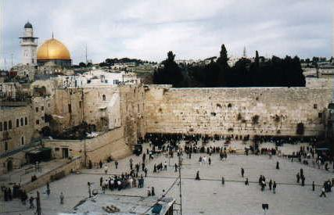
The Jewish kingdom
The first Jewish kingdom was established in Palestine 1400 B.C.
The Western Wall

Slide 5
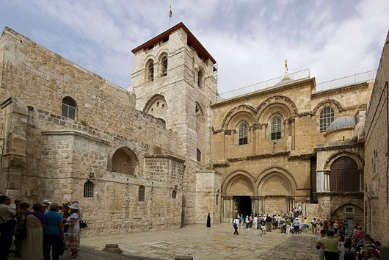
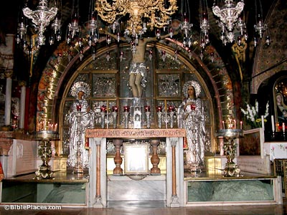
The Church of the holy sepulcher
Place of Crucifixion
It is said that the tomb of Jesus is in the church, discovered in the 19th century

Slide 6
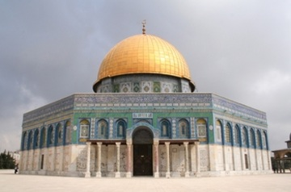
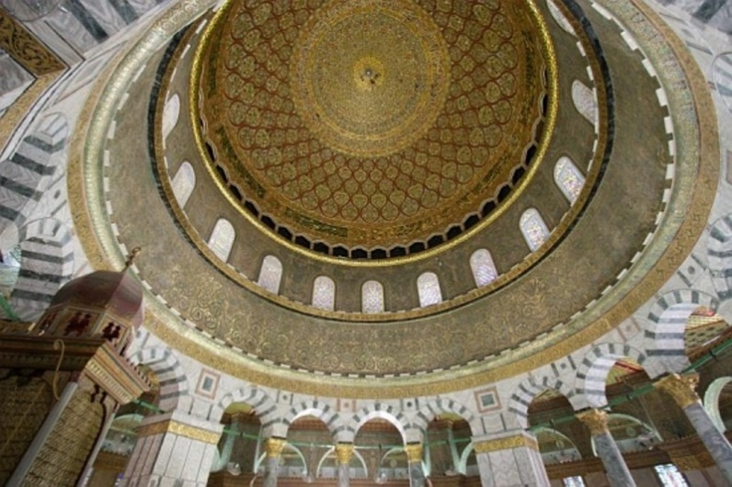
The dome of the rock
A holy mosque for Muslims
It is believed that it stands on a holy rock
A holy place for Jews
It was believed that the dome is the biblical temple of Solomon

Slide 7
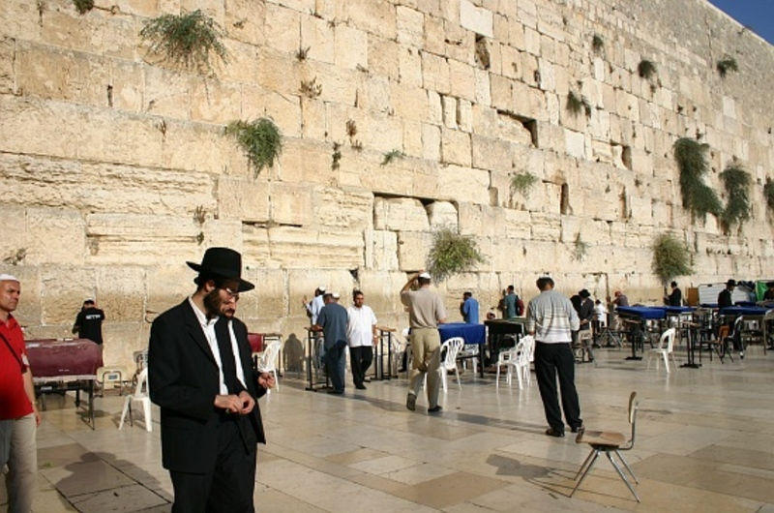
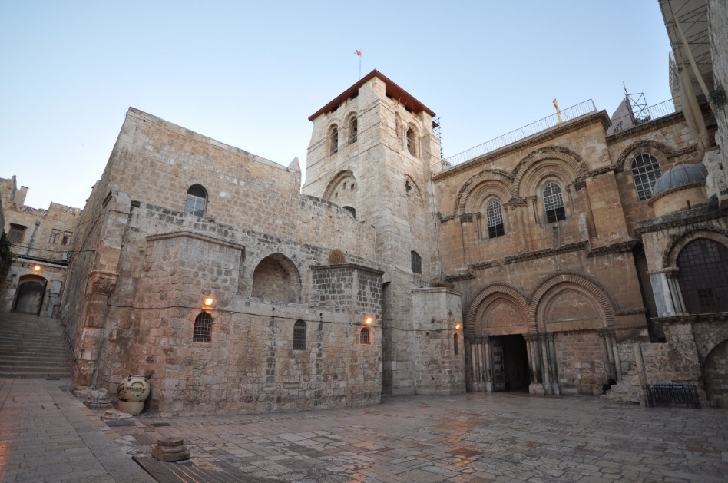
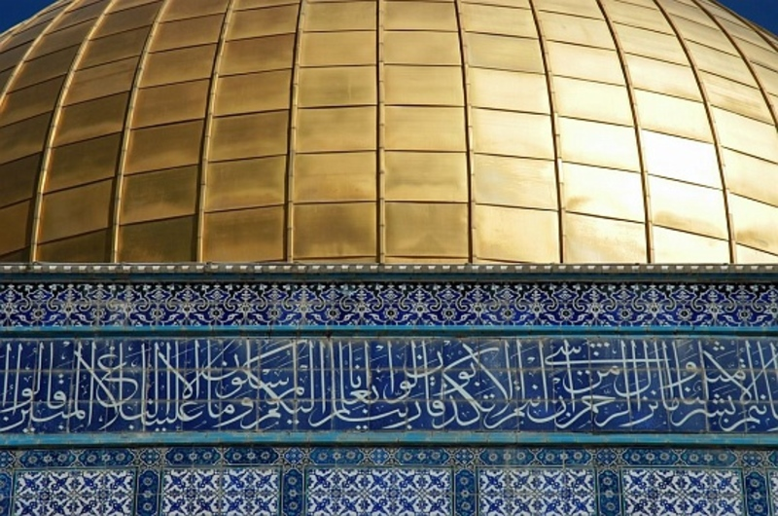
Holy
Sites

Slide 8
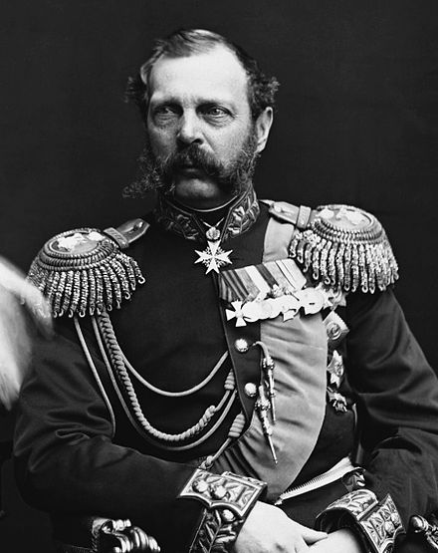
Beginning of immigration
Immigration of Jews started in 1881 when czar alexander ii was assassinated and his son took over in Russia
1904, the second round of immigration began
  They hated that Arabs worked on their holy land
  They believed they had to work on the land which in turn created tension

Slide 9
A sudden change of ownership
After WWI, Britain took over Palestine and established it as the national Jewish home “Balfour declaration”
Britain established Palestine as the national Jewish home one month before ceasing it
Even though the declaration was before the British had authority over Palestine, it became effective, due to the allied forces agreeing on it

Slide 10
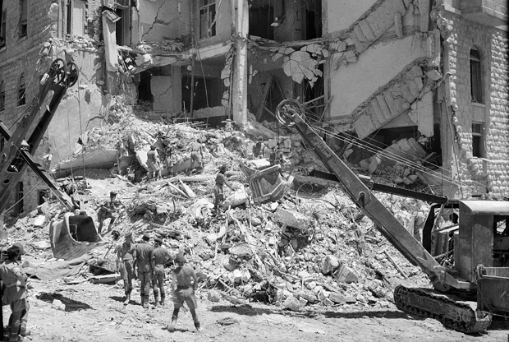
A bloody transition
King David hotel bombing
Tension rose between the Palestinians and the new immigrants
Up until Britain lost control of the situation and surrendered Palestine

Slide 11
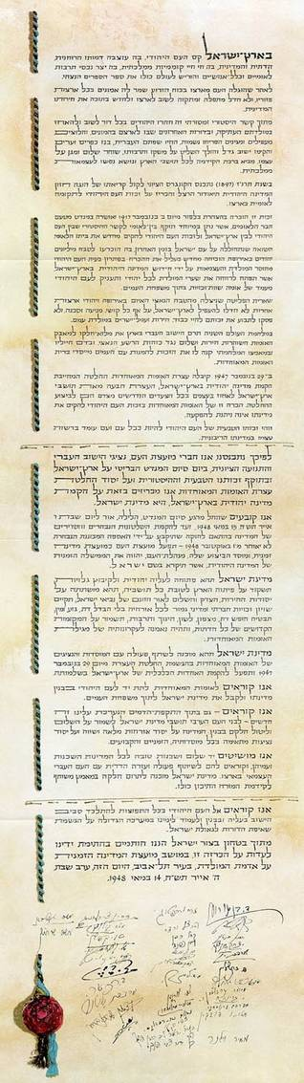
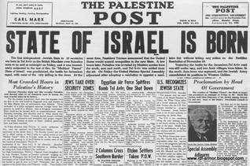
The end of Palestine “alnakba”
In 1948, State of Israel was born.
Arabs attacked a day later and lost
The lands of the Palestinians decreased dramatically
The conflict continues to this day

Slide 12
The conflict continues “1967”
Then in 1967, Russia falsely informed the Syrian army that Israel was planning on attacking Syria
Egypt sent its troops and a war took place
Israel defeated Egypt, Syria, and Jordan
The lands of the Palestinians increased dramatically

Slide 13
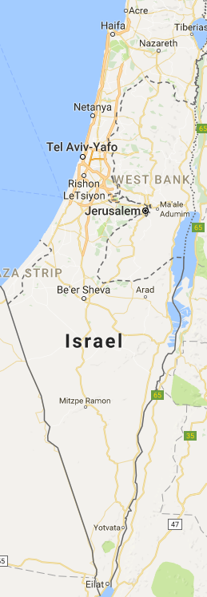
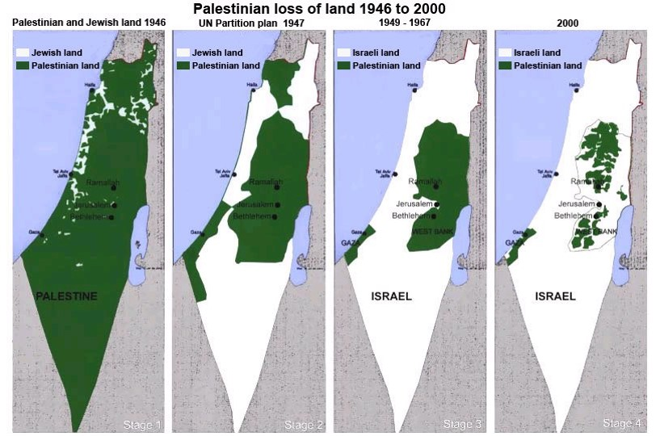
*Palestine went from 94% inhabited by Palestinians, to just about 14%

Slide 14
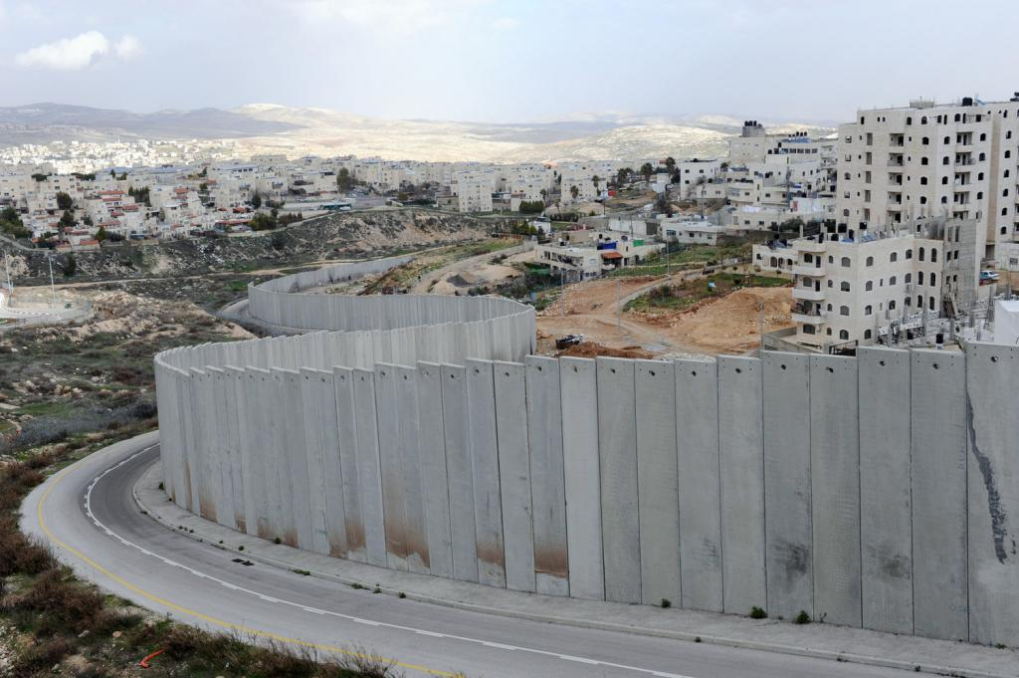
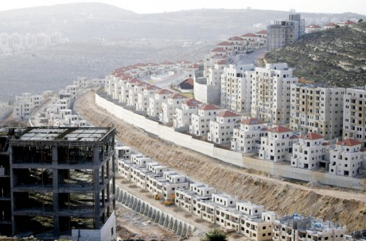
The wall and settlements
Designed to separate Palestinians from Israelis

Slide 15
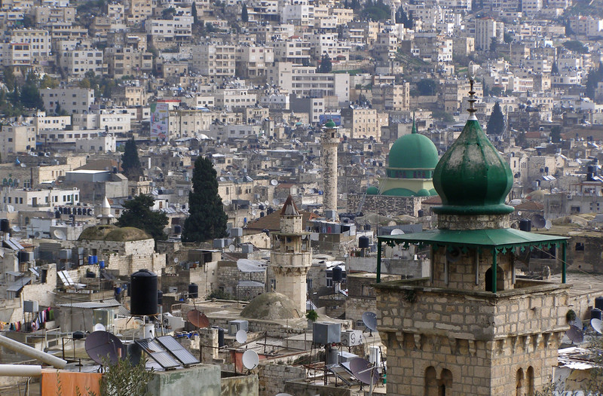
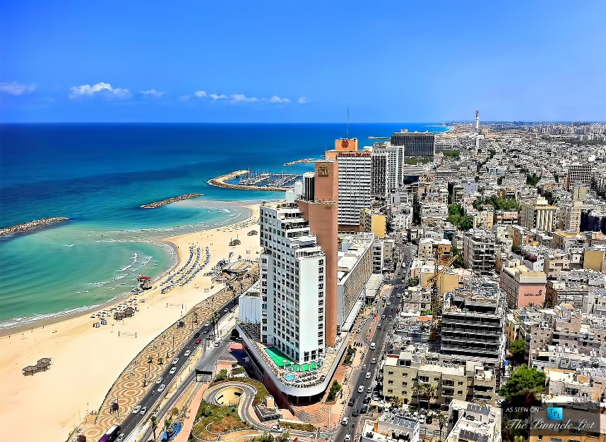
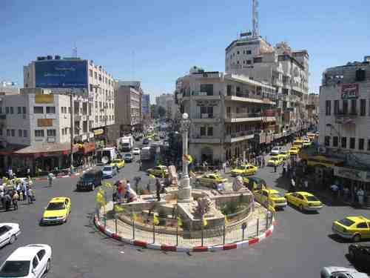
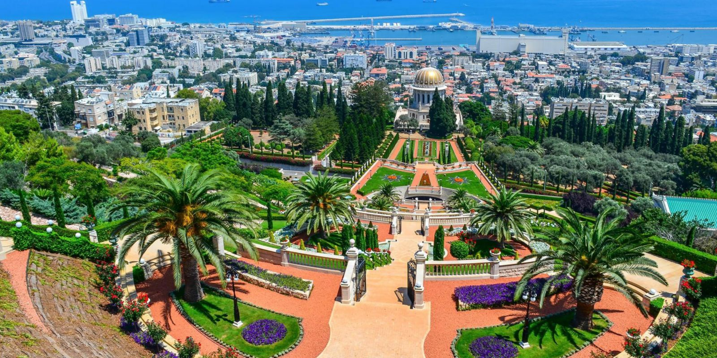
Palestine
Israel
VS.

Slide 16
Economy
The UN states that Palestinian economy would double without Israeli occupation
Restrictions on goods and imports
Losses of land, water, and other resources
Air and sea blockade in Gaza
Illegal expansions of Israeli settlements
Israel has control over 60% of the west bank
According to the world bank, unemployment is at 26%
Dependent on foreign aid

Slide 17
Culture and Values
Family
Religion
Honor
Hospitality
Holidays are Eid al-Adha and eid Al-Fitr and Christmas
kufeyya

Slide 18
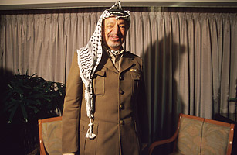
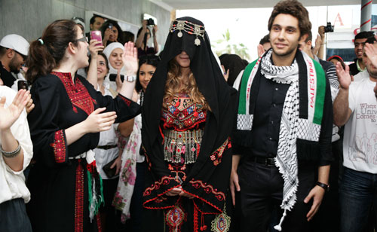
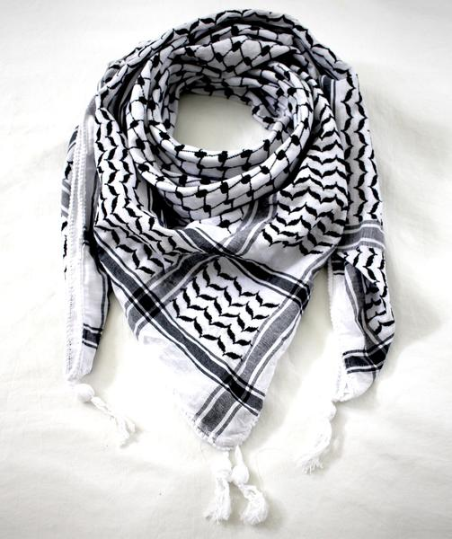
Kufeyya

Slide 19
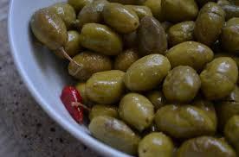
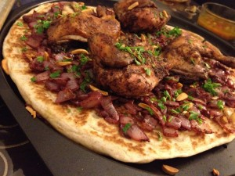
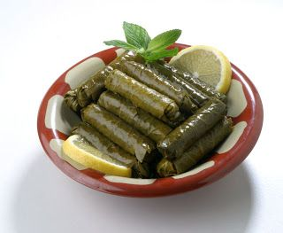
Food

Slide 20
